Slide 1
The IPCC Circle of Lies
Five Papers Falsify
the Entire Framework
Jonathan Cohler
cohler@post.harvard.edu
17th International Climate and Energy Conference (IKEK-17)
June 26-27, 2026
Halle an der Saale
Notes:
The Emperor Has No Clothes. You know the story. Swindlers convince an entire kingdom to applaud robes that don't exist, until one child states the obvious.
Our version is worse than Andersen’s, though, because in ours the swindlers took over the schools.

Slide 2
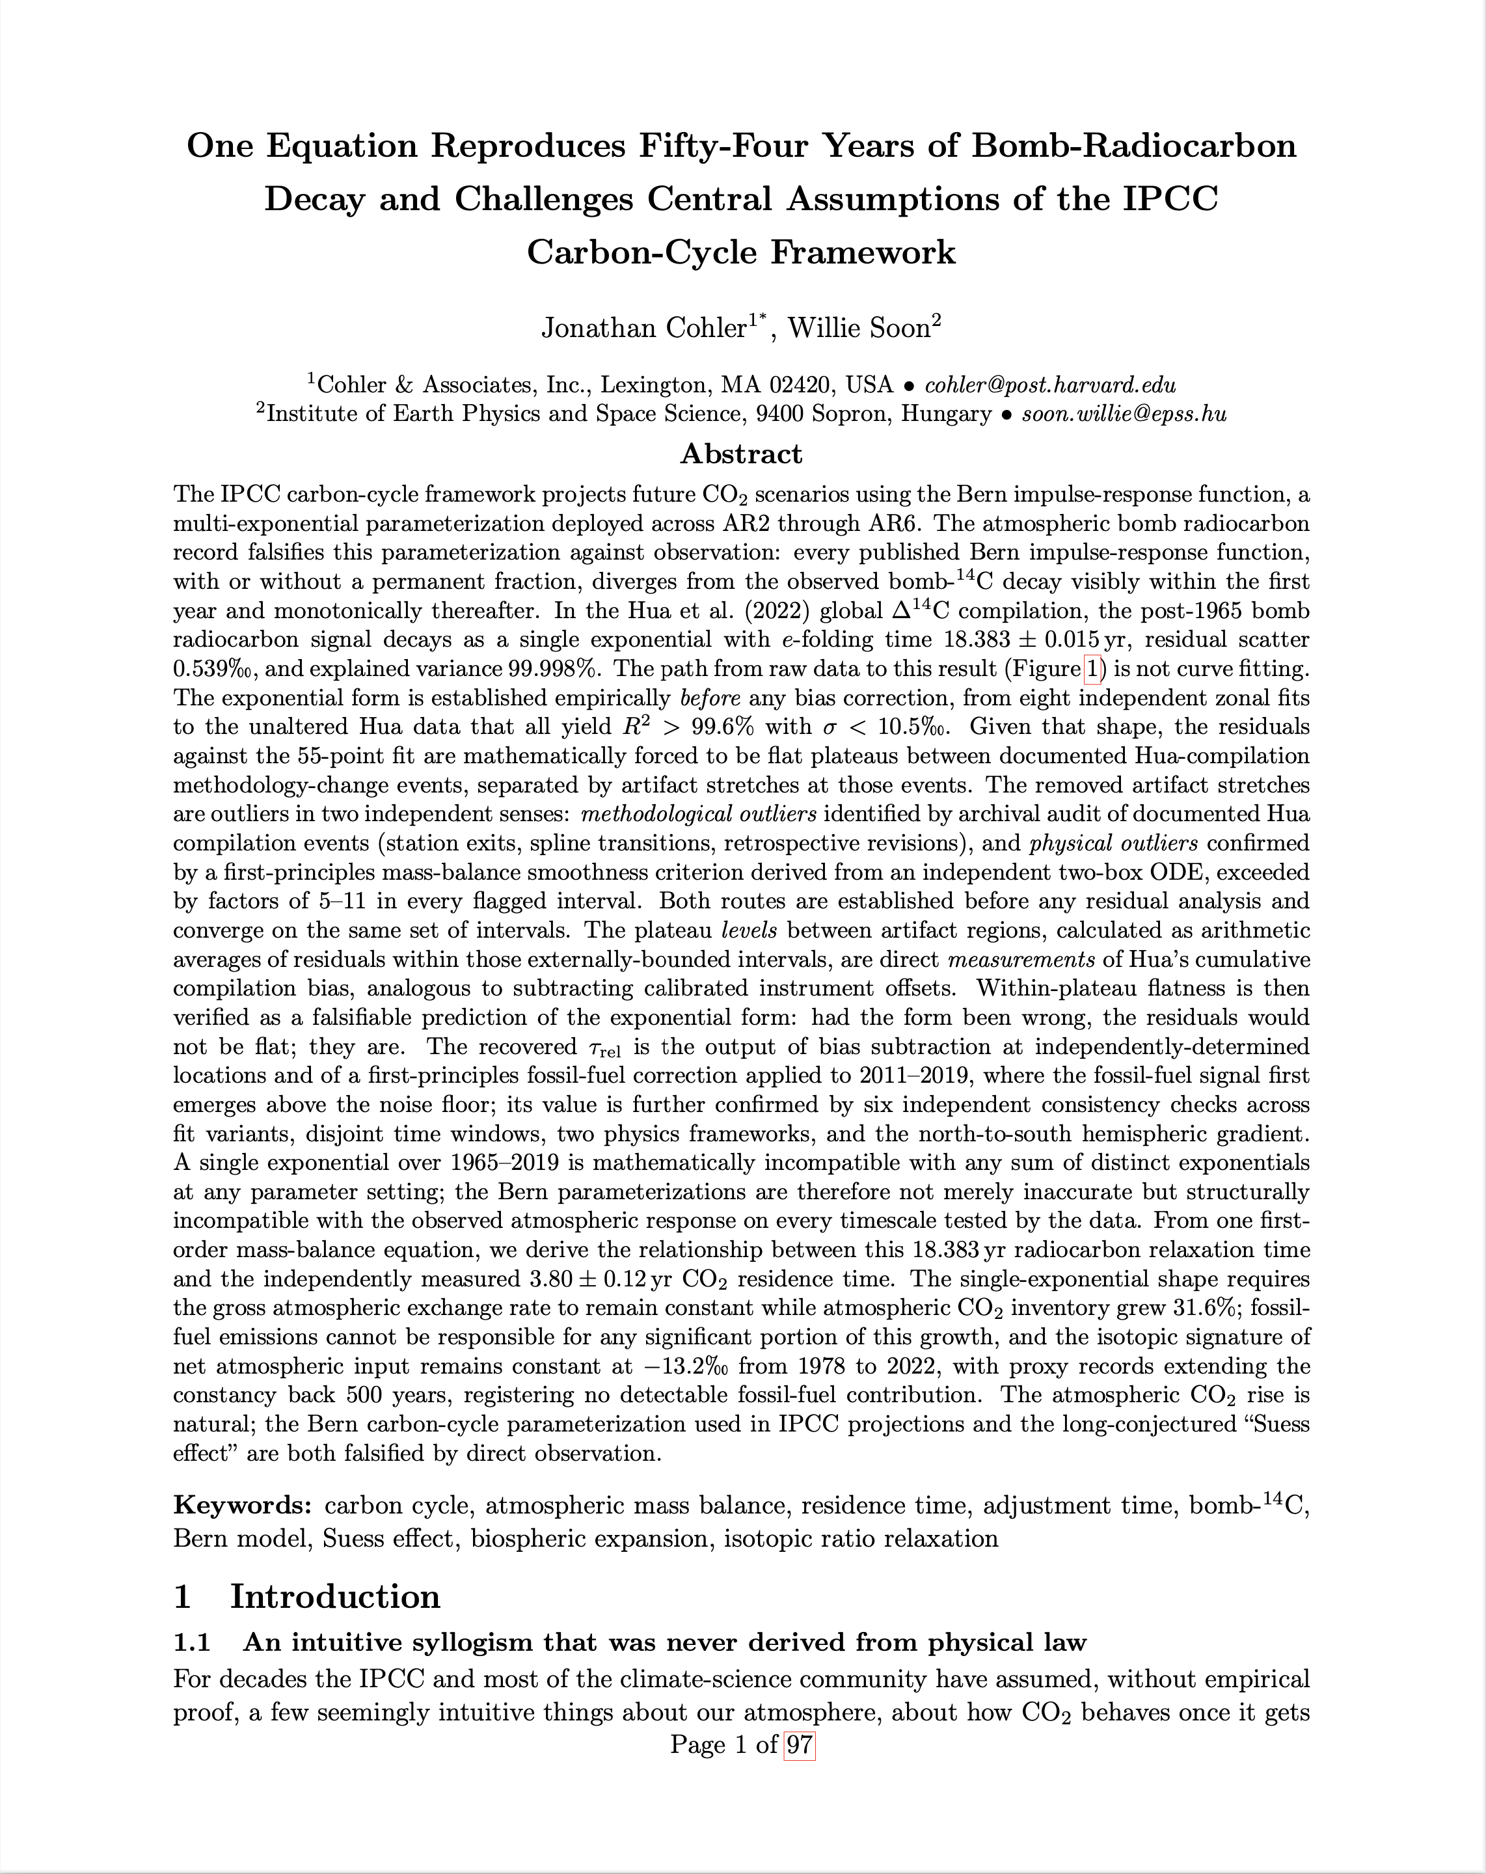
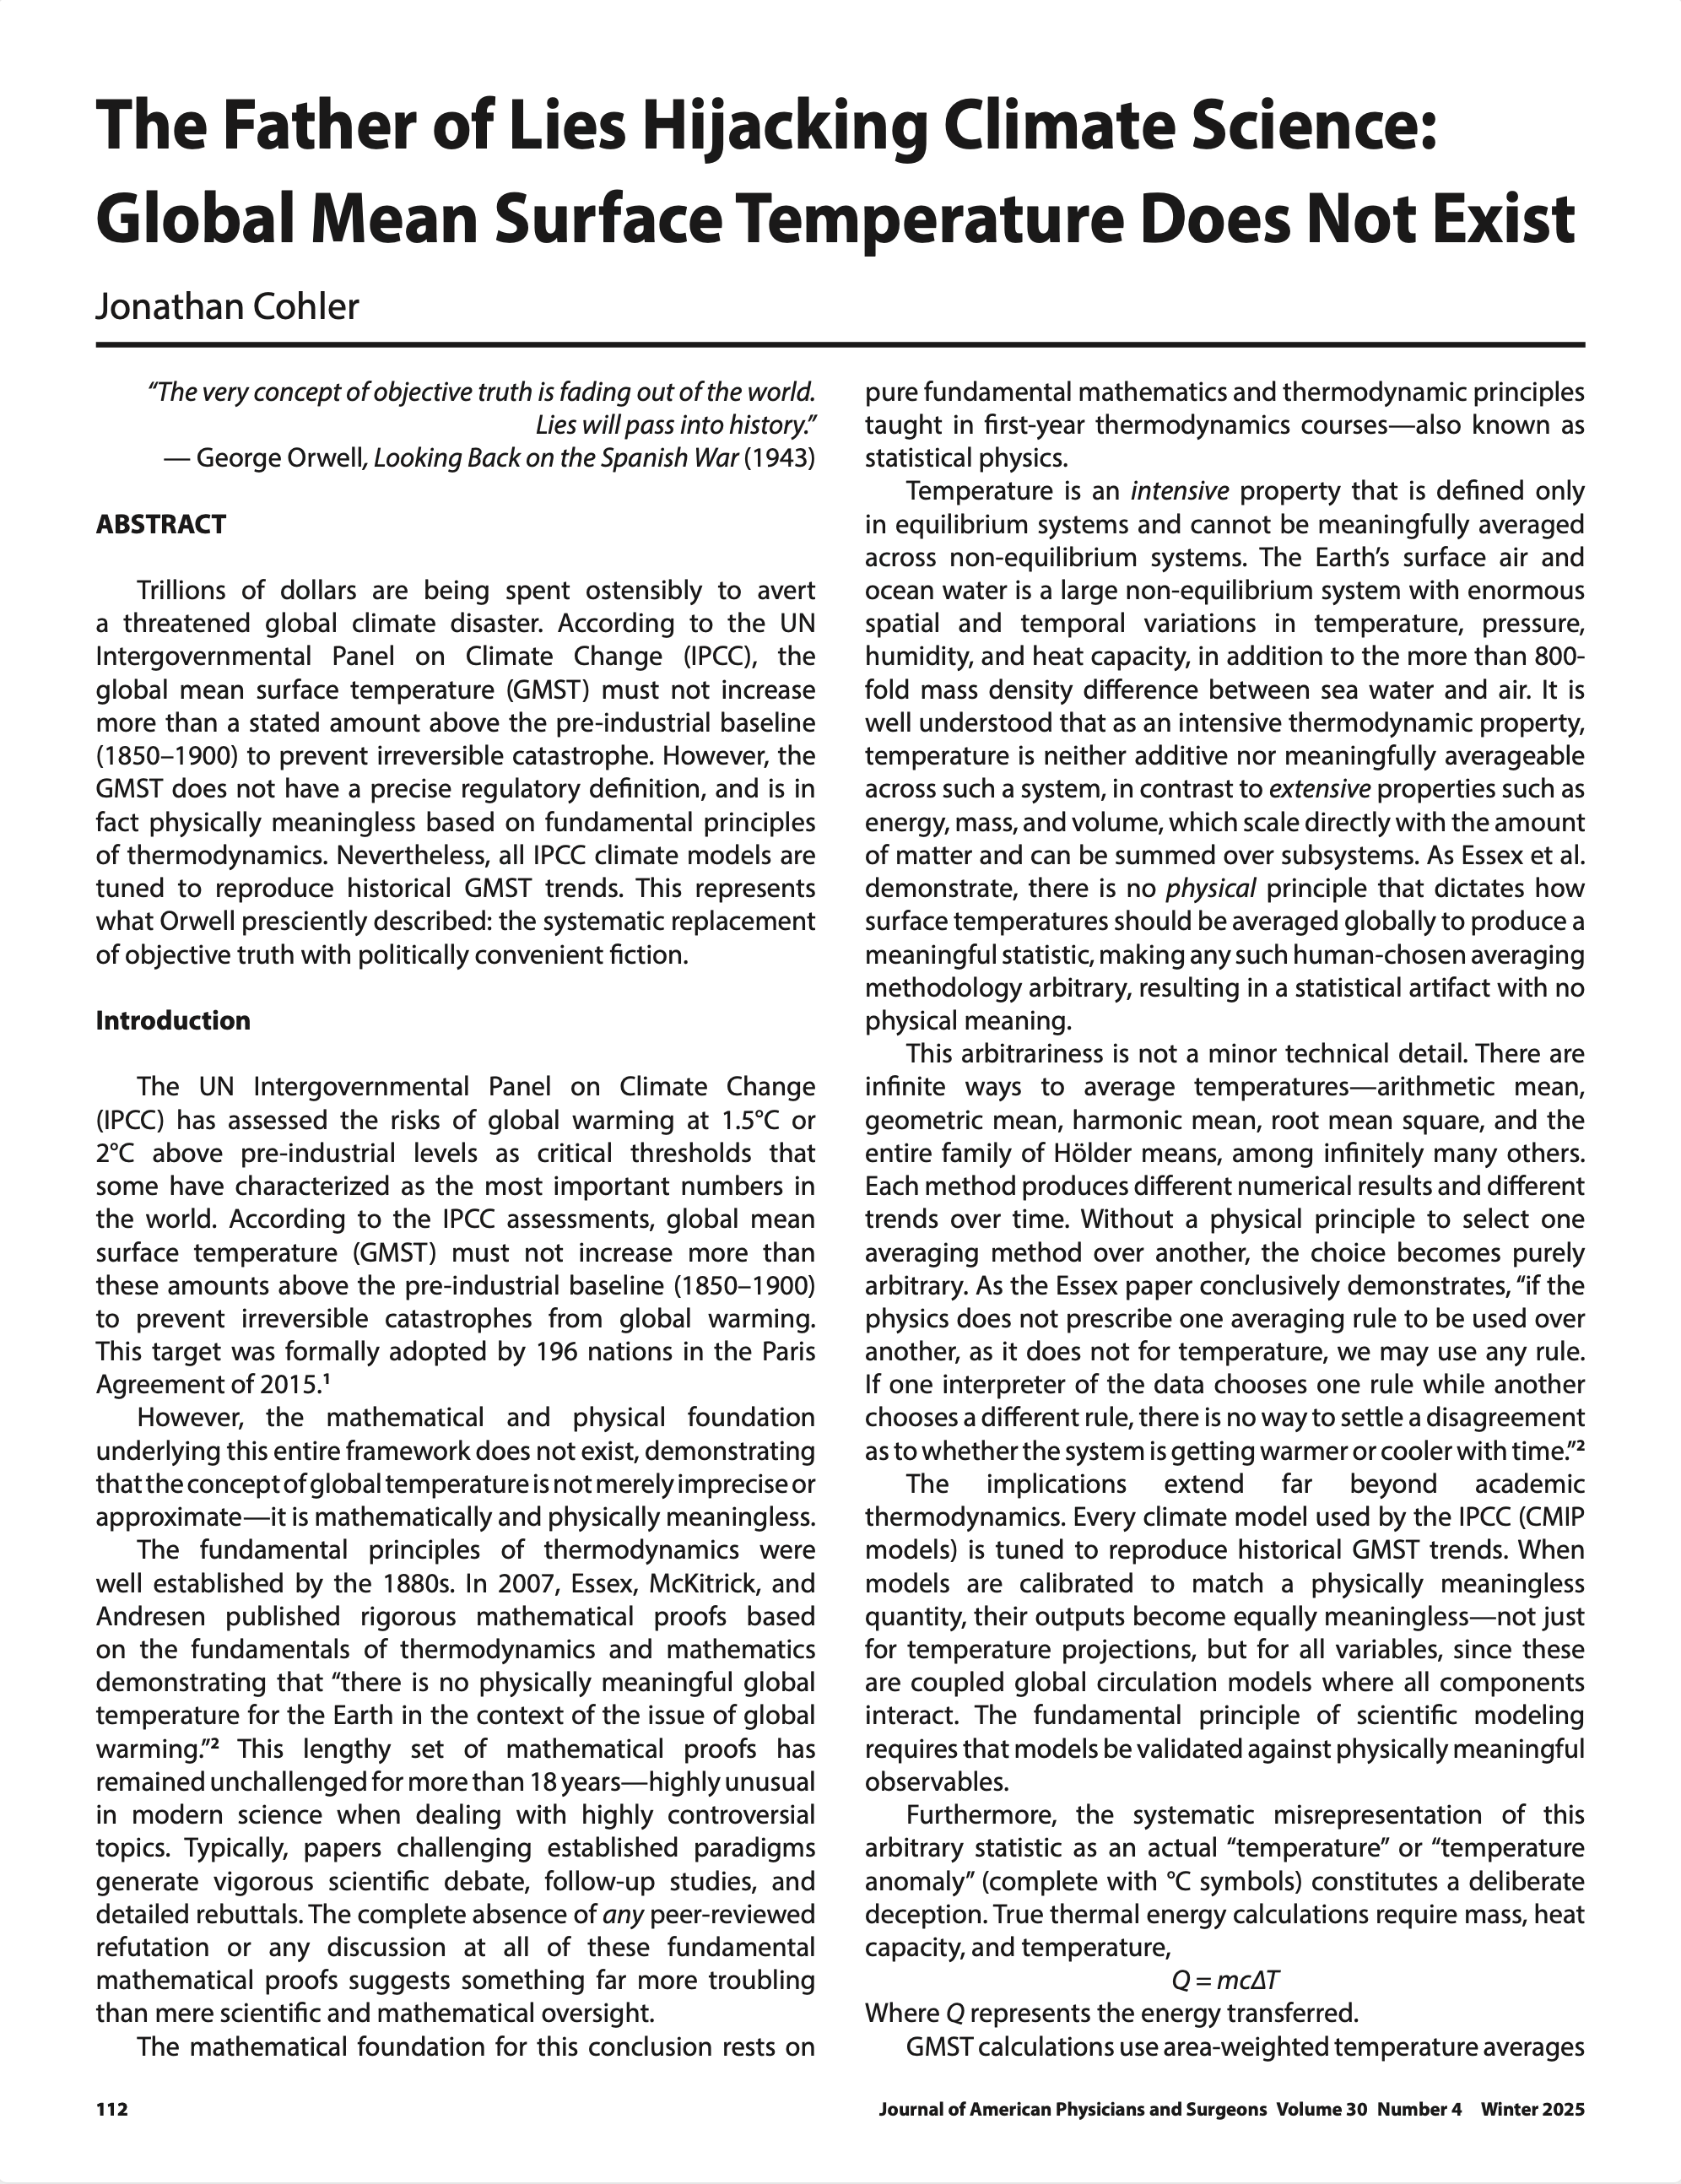
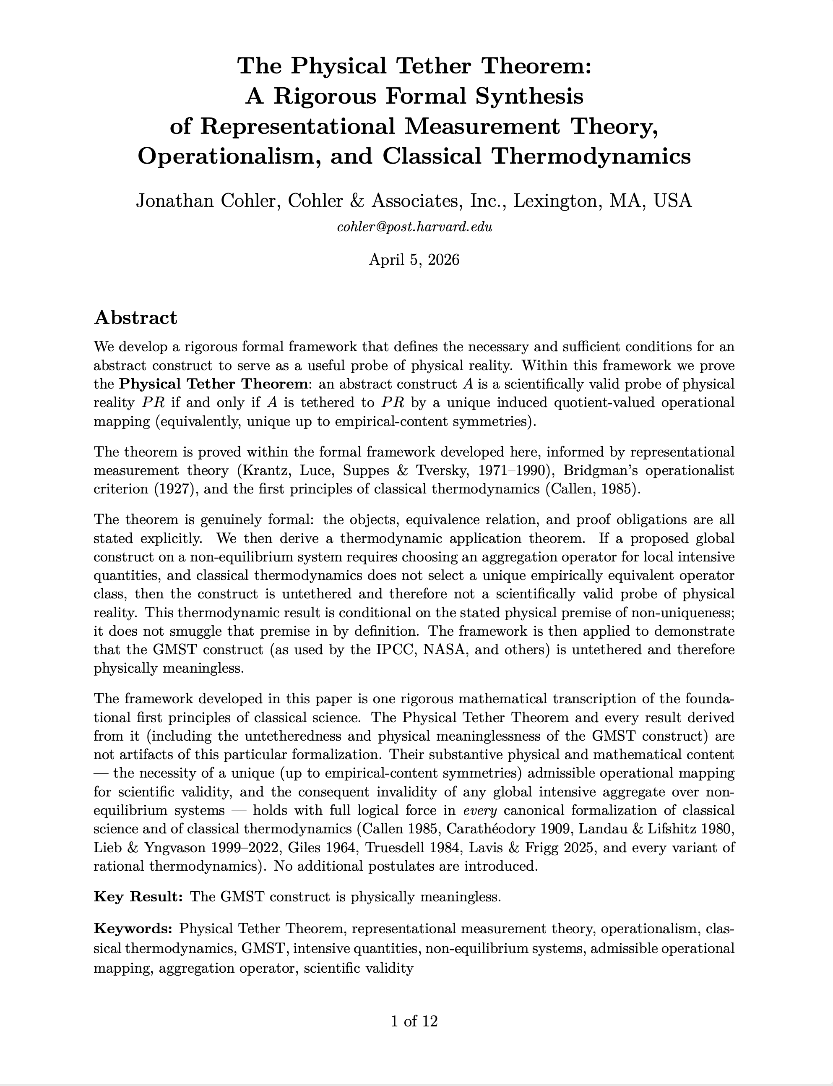
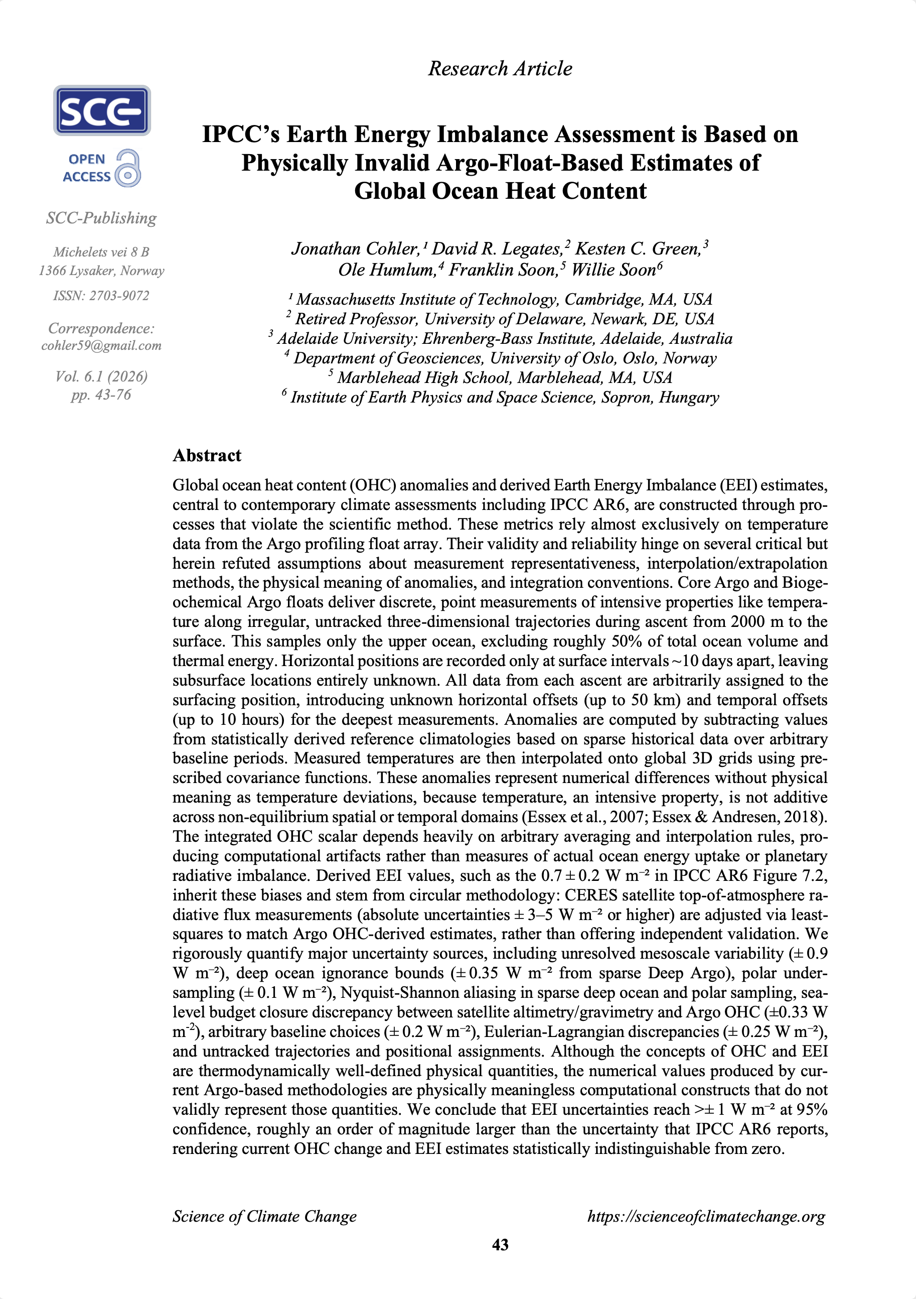
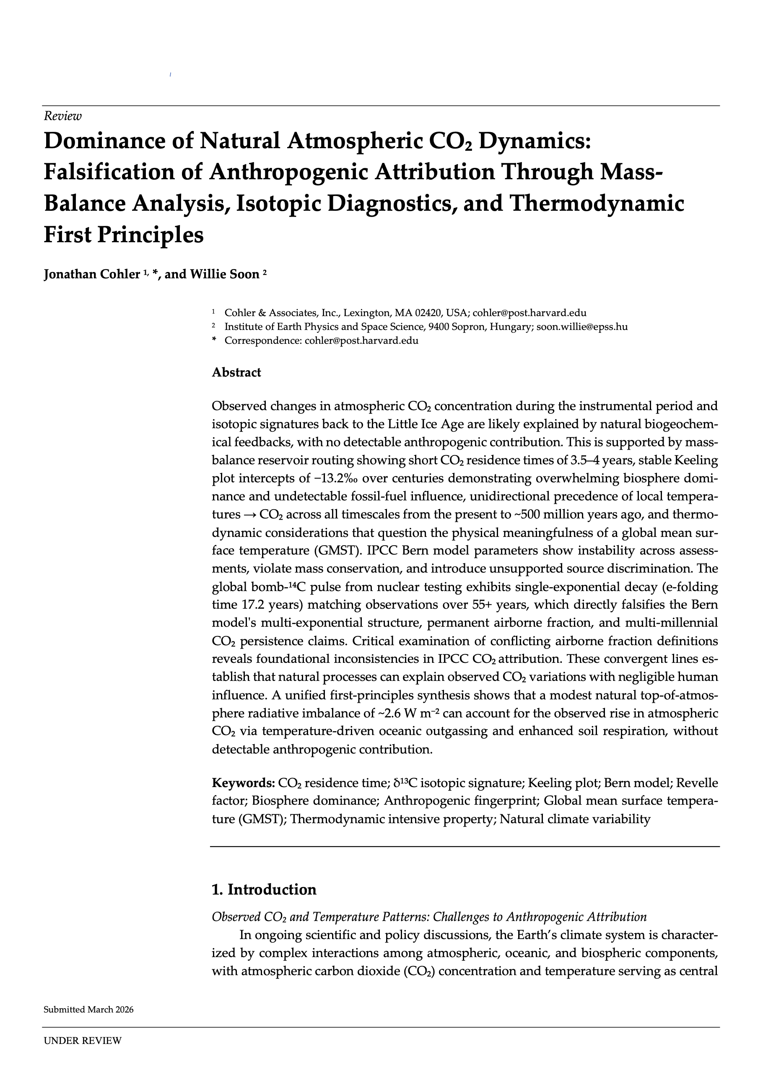
Five Papers
The scientific foundation of this presentation
1
The Father of Lies Hijacking Climate Science: Global Mean Surface Temperature Does Not Exist
Cohler, J. • Journal of American Physicians and Surgeons, 30(4), 2025
2
IPCC's Earth Energy Imbalance Assessment is Based on Physically Invalid Argo-Float-Based Estimates of Global Ocean Heat Content
Cohler, J., Legates, D. R., Green, K. C., Humlum, O., Soon, F., & Soon, W. • Science of Climate Change, 6(1), 2026
3
Dominance of Natural Atmospheric CO₂ Dynamics: Falsification of Anthropogenic Attribution Through Mass-Balance Analysis, Isotopic Diagnostics, and Thermodynamic First Principles
Cohler, J. & Soon, W. • Under Review, 2026
4
The Physical Tether Theorem: A Rigorous Formal Synthesis of Representational Measurement Theory, Operationalism, and Classical Thermodynamics
Cohler, J. • Preprint, 2026
5
One Equation Reproduces Fifty-Four Years of Bomb-Radiocarbon Decay and Challenges Central Assumptions of the IPCC
Carbon-Cycle Framework
Cohler, J. & Soon, S. • Preprint, 2026
Notes:
My presentation is based on four papers.
My 2025 peer-reviewed paper in the Journal of American Physicians and Surgeons building on Essex et al. (2007) and proving again that GMST does not exist. [CLICK]
Our 2026 peer-reviewed paper in Science of Climate Change on the invalidity of Argo-based Ocean Heat Content, with co-authors David Legates, Kesten Green, Ole Humlum, Franklin Soon, and Willie Soon. [CLICK]
Our 2026 paper with co-author Willie Soon on the dominance of natural CO₂ dynamics, currently under review. [CLICK]
And my hot-off-the-press preprint paper proving my new theorem called The Physical Tether Theorem. [CLICK]
I want to acknowledge all my co-authors, and in particular my mentor and dear friend Willie Soon, whose decades of courageous work made much of this possible.
I also want to honor the truly seminal contributions of Christopher Essex, whose work laid the foundation for all my papers here, and Demetris Koutsoyiannis, whose isotopic analysis and reservoir routing papers are truly new foundations of climate science.

Slide 3
The Verdict
EVERY major public-facing claim of the Intergovernmental Panel on Climate Change (IPCC) is:
Scientifically invalid
Categorically FALSE
Notes:
Temperature is what physicists call an intensive property. It belongs only to a system in equilibrium.
You can’t meaningfully average the temperature of a system spanning 120°C differences between hot and cold locations,
And with an 800-fold density difference and a 4x heat capacity difference between seawater and air, you cannot average across such a system.

Slide 4

The Empty IPCC Circle of Lies
GMST
1. GMST
Global Mean Surface Temperature
Physically Meaningless
2. CMIP
Coupled Model Intercomparison Project
Tuned to match GMST
CMIP
[EMPTY]
3. OHC
Ocean Heat Content
Meaningless Calculation
CO₂
4. EEI
Earth’s Energy Imbalance
“Constrained” by OHC
OHC
5. CO₂
Carbon Dioxide, The Gas of Life
Undetectable Signature
EEI
Each lie leads to the next.
None stand on their own.
Notes:
For 38 years, the IPCC has paraded a framework that looks robust — draped in equations, satellite data, supercomputer models, Academy Awards and even Nobel Prizes.
But it is a snake eating its own tail, in which each piece appears to validate the next. Once you understand that the circle is EMPTY, the entire house of cards collapses.
Each lie leads to the next. None stand on their own. [CLICK]
Global Mean Surface Temperature (GMST) is the number that has supposedly risen 1.1 degrees Celsius since 1850.
The number whose further rise to 1.5 or 2 degrees is “catastrophic.”
“The most important number in the world.”
GMST was proven meaningless in a 2007 paper by Essex, McKitrick, and Andresen, unrefuted in 19 years of peer-reviewed literature.
Last week, I released my paper on my new Physical Tether Theorem, providing strict mathematical formalism to translate the universal principles of classical science into a formal math theorem.
In one step, it categorically PROVES that GMST DOES NOT EXIST in the real world.
It cannot exist.
It is COMPLETELY physically meaningless.

Slide 5
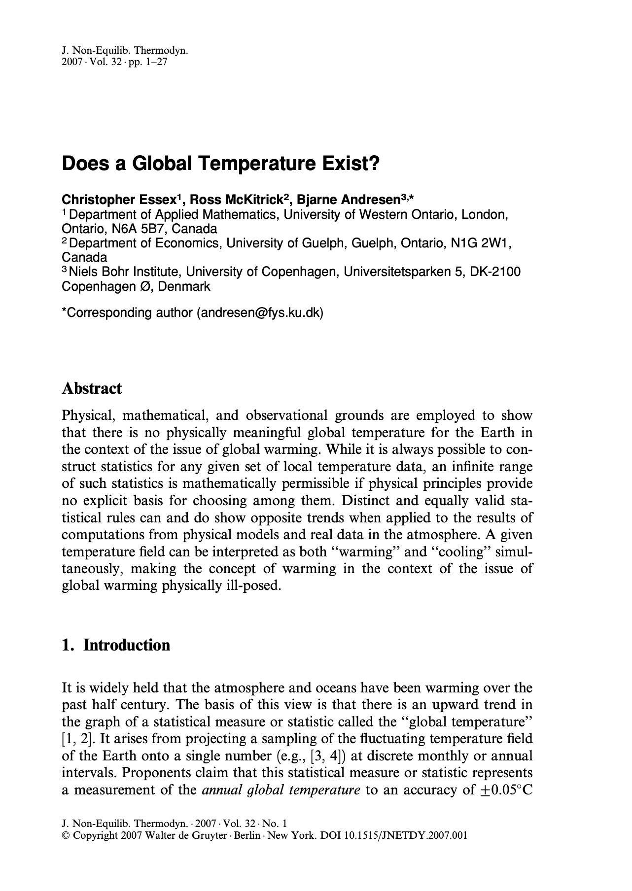
ESSEX ET AL. (2007)
“there is no physically meaningful global temperature for the Earth in the context of the issue of global warming.”
Notes:
Essex et al. 2007 concluded [CLICK]
'there is no physically meaningful global temperature for the Earth in the context of the issue of global warming.’
Unrefuted for 19 years.

Slide 6
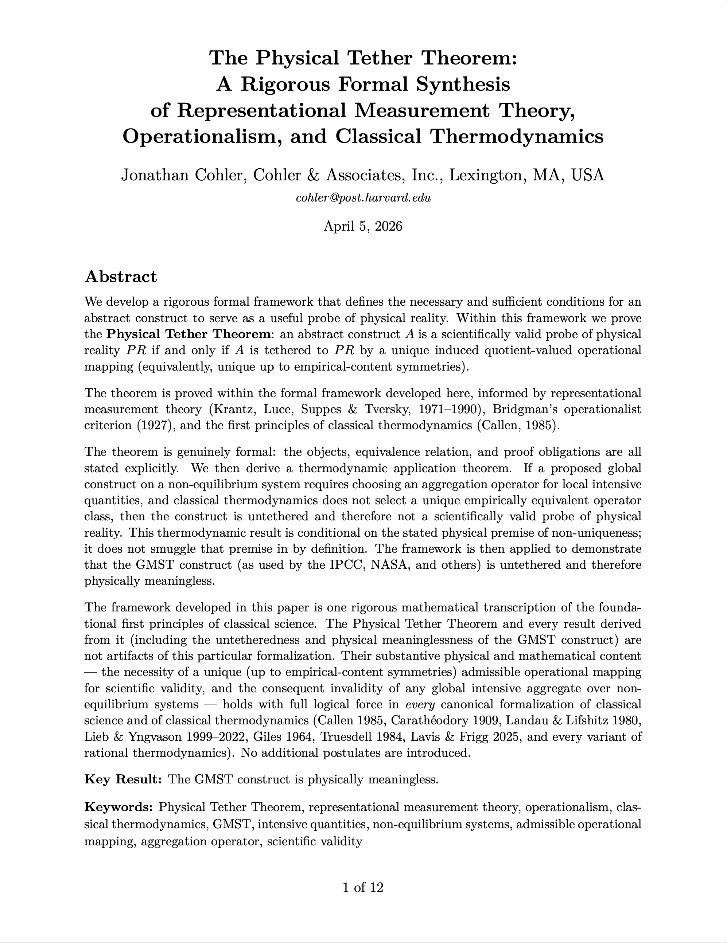
“…the GMST construct (as used by the IPCC, NASA, and others) is untethered and therefore physically meaningless.”
COHLER (2026)
Notes:
Last week I released my Physical Tether Theorem. [CLICK]
It proves absolutely, from first principles, that the GMST construct as used by the IPCC, NASA, and others is physically meaningless.

Slide 7
Telephone numbers
Boston: +1-617-555-2847
Halle: +49-345-115
————————————————————————————
Average: ???-???-????
————————————————————————————
1. Whose phone number is it?
2. Is it a phone number?
3. Does it mean anything at all?
Same three questions re “global temperature”?

Slide 8
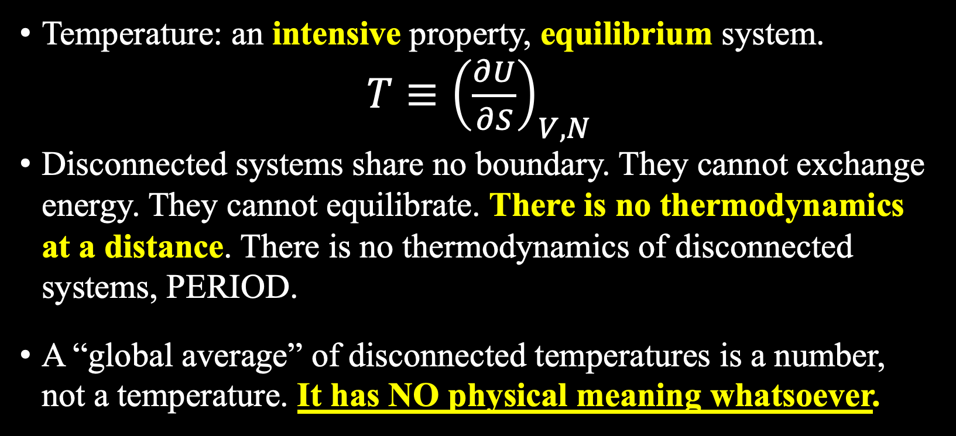
The Myth of Temperature Averaging
Temperature: an intensive property, equilibrium system.
$T≡{\left(\frac{∂U}{∂S}\right)}_{V,N}$
Disconnected systems share no boundary. They cannot exchange energy. They cannot equilibrate. There is no thermodynamics at a distance. There is no thermodynamics of disconnected systems, PERIOD.
A “global average” of disconnected temperatures is a number, not a temperature. It has NO physical meaning whatsoever.
Notes:
Temperature is what physicists call an intensive property. It belongs only to a system in equilibrium.
You can’t meaningfully average the temperature of a system spanning 120°C differences between hot and cold locations,
And with an 800-fold density difference and a 4x heat capacity difference between seawater and air, you cannot average across such a system.

Slide 9
The Physical Tether Theorem
An abstract math formula is scientifically valid if and only if it is connected to the physical world by a unique physical-law-governed objective link.
✓ Connected equilibrated system
T ≡ (∂U/∂S) _{V,N}
Every valid thermometer agrees.
Unique mapping exists.
✗ Disconnected systems (GMST)
No physics. No mapping.
Arbitrary statistical aggregations with no unique operational definition.
The outputs are meaningless numbers.
GMST is a number
theIPCC has FALSELY labeled as a temperature.

Slide 10
Consequences: Immediate & TOTAL
GMST is physically meaningless. A few IPCC examples…
1
✗
2
✗
3
✗
4
✗
1.5 °C
IPCC AR6 &
Paris target
———————
Not a physical threshold. A number with a fake label.
1.1 °C
IPCC AR6
"warming"
since 1850
———————
Not a measurement. Physical fiction.
ECS
"Equilibrium"
climate sensitivity
———————
Modeled ΔGMST per CO₂ doubling. Two voids, subtracted.
>50%
IPCC AR5
human attribution
———————
Regression on a dependent variable that does not exist.
Every IPCC claim built on GMST:
Null and void.

Slide 11
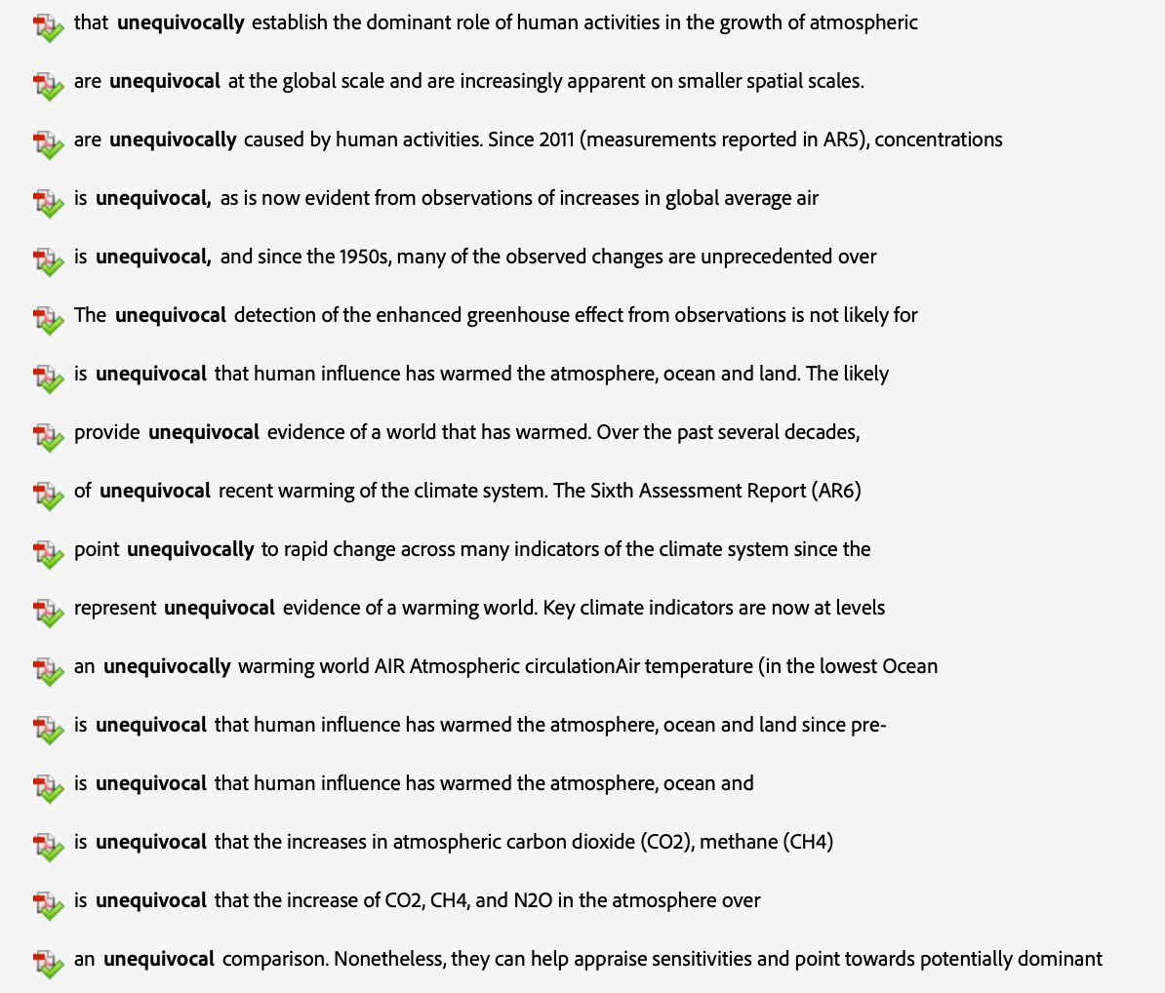
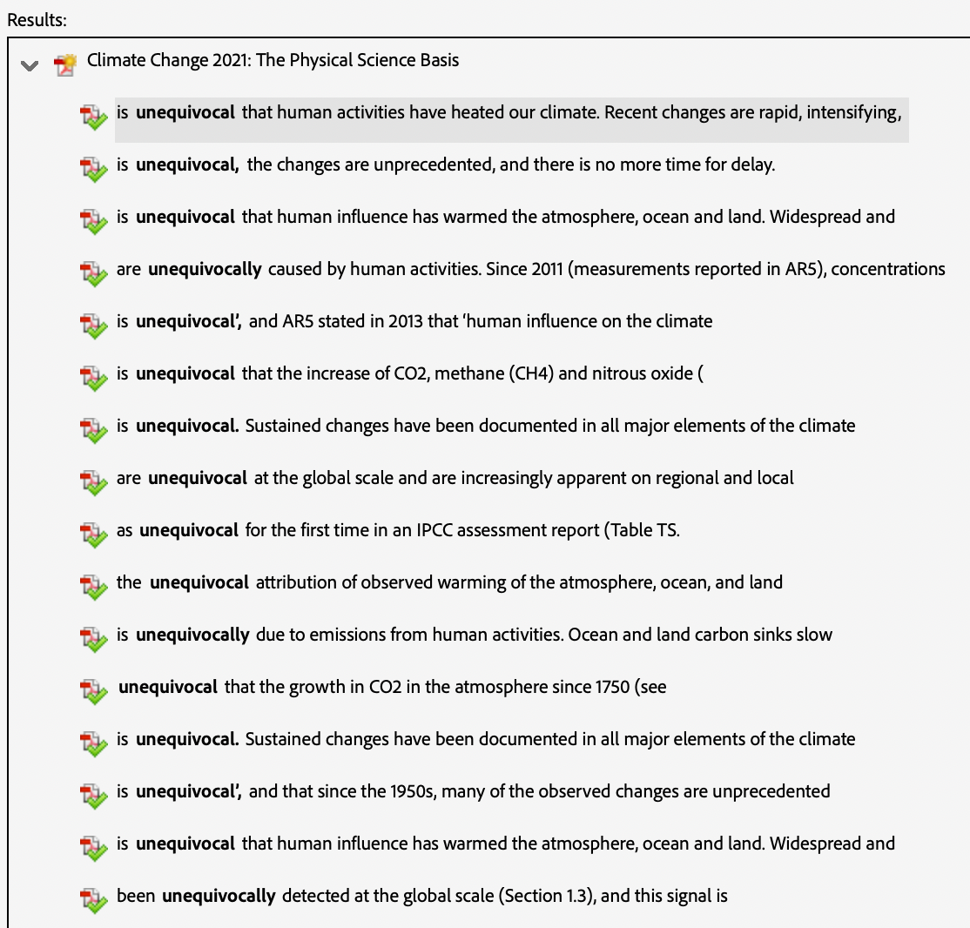
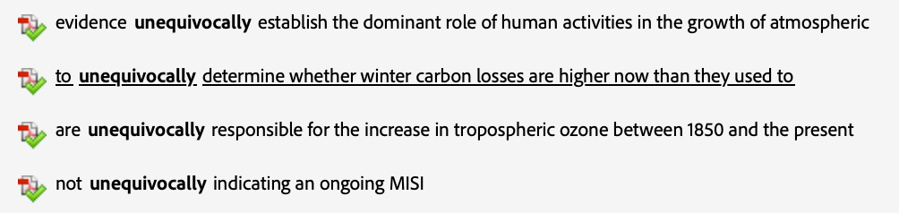
AR6: UNEQUIVOCAL

Slide 12
IPCC Abandoned Science
37x
“It is unequivocal that human influence has warmed the atmosphere, ocean and land.”
— IPCC AR6, Summary for Policymakers
“unequivocal”
in AR6
“A theory which is not refutable by any conceivable event is non-scientific. Irrefutability is not a virtue of a theory (as people often think) but a vice.”
— Karl R. Popper, Conjectures and Refutations, 1963
“Unequivocal” is not science.

Slide 13
The Empty IPCC Circle of Lies
GMST
1. GMST
Global Mean Surface Temperature
Physically Meaningless
2. CMIP
Coupled Model Intercomparison Project
Tuned to match GMST
CMIP
[EMPTY]
3. OHC
Ocean Heat Content
Meaningless Calculation
CO₂
4. EEI
Earth’s Energy Imbalance
“Constrained” by OHC
OHC
5. CO₂
Carbon Dioxide, The Gas of Life
Undetectable Signature
EEI
Each lie leads to the next. None stand on their own.
Notes:
Now, CMIP. The climate models.

Slide 14
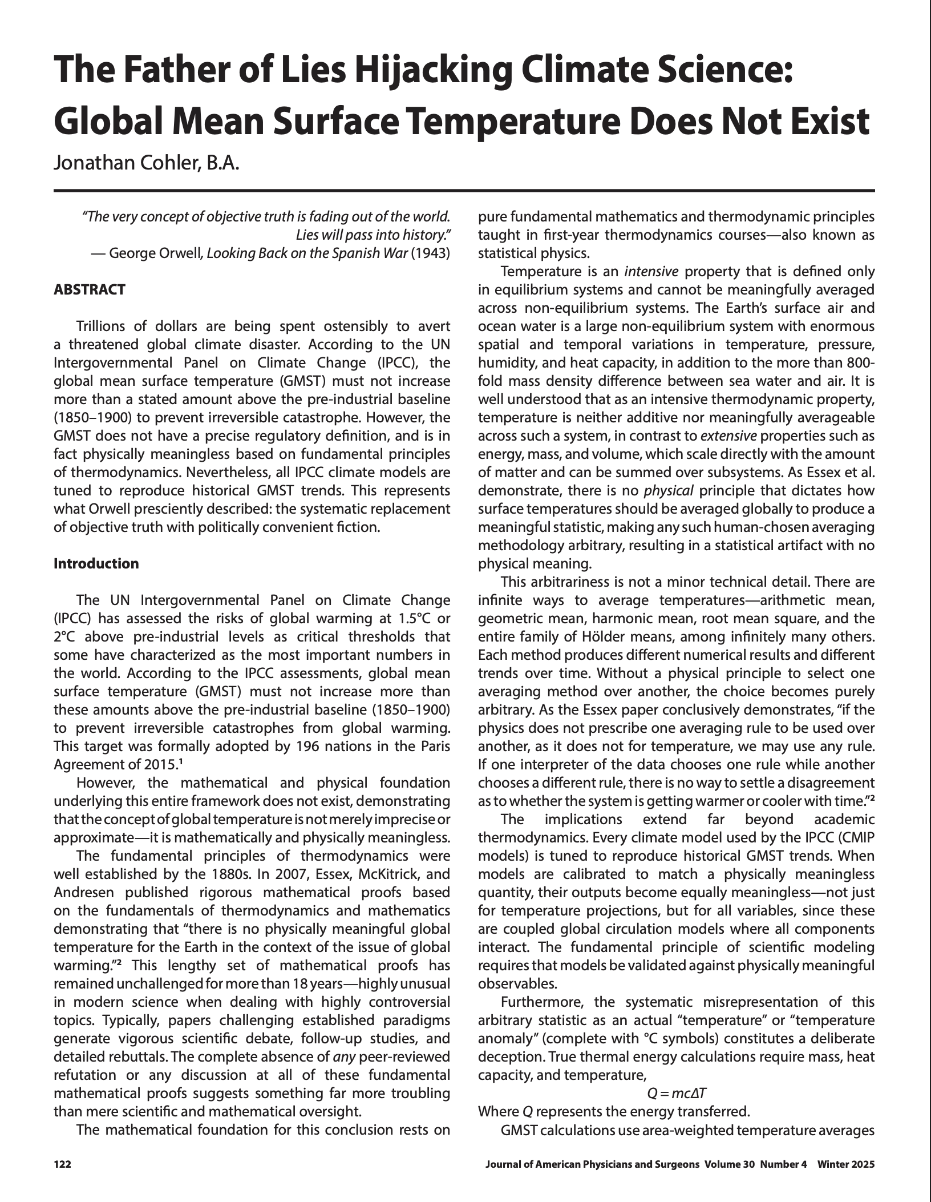
“Every climate model used by the IPCC (CMIP models) is tuned to reproduce historical GMST trends. When models are calibrated to match a physically meaningless quantity, their outputs become equally meaningless—not just for temperature projections, but for all variables, since these are coupled global circulation models where all components interact. The fundamental principle of scientific modeling requires that models be validated against physically meaningful observables”
COHLER (2025)
Notes:
My 2025 paper shows every CMIP model is tuned to reproduce GMST. A meaningless quantity.

Slide 15
“Tune”
models to match
GMST
Not a physical quantity
CMIP models
Hundreds of tunable parameters
↻
“Validate”
against same GMST
Policy projections
Trillions of $$$ in climate spending
Tuning to a meaningless quantity
produces meaningless outputs!
Notes:
The coupled global circulation models underlying all climate projections — are explicitly tuned, calibrated, and validated against historical GMST trends. [CLICK]
You build complex models, built on unsolved Navier-Stokes equations, and hundreds of adjustable parameters. Adjust those parameters until the models reproduce the trajectory of meaningless GMST. [CLICK]
Call this validation. [CLICK]
Use those models to drive trillions in global energy policy. [CLICK]
Therefore, the outputs from the CMIP models are equally meaningless, for all variables, not just temperature.

Slide 16
The Empty IPCC Circle of Lies
GMST
1. GMST
Global Mean Surface Temperature
Physically Meaningless
2. CMIP
Coupled Model Intercomparison Project
Tuned to match GMST
CMIP
[EMPTY]
3. OHC
Ocean Heat Content
Meaningless Calculation
CO₂
4. EEI
Earth’s Energy Imbalance
“Constrained” by OHC
OHC
5. CO₂
Carbon Dioxide, The Gas of Life
Undetectable Signature
EEI
Each lie leads to the next. None stand on their own.
Notes:
Now, Ocean Heat Content.

Slide 17
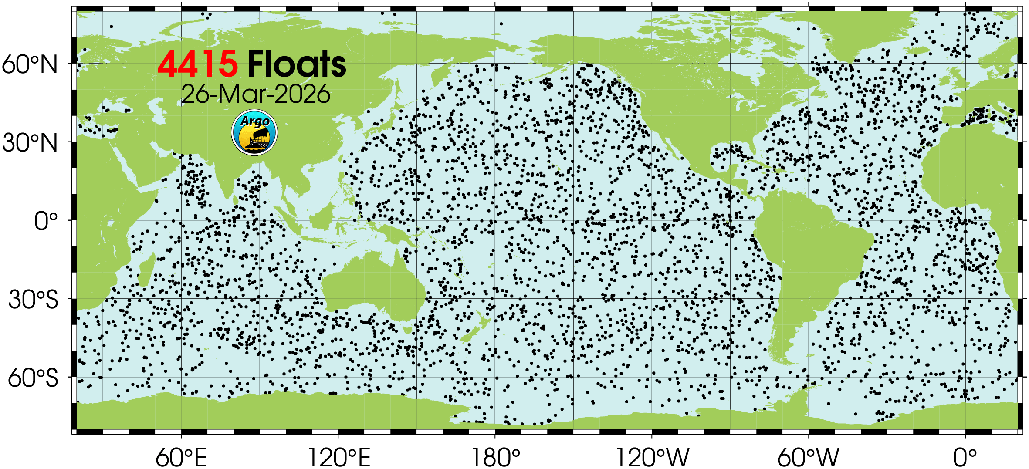
Argo
Notes:
The official Argo map looks impressive, but it’s cropped to hide the poles and doesn’t distinguish deep from upper floats.

Slide 18
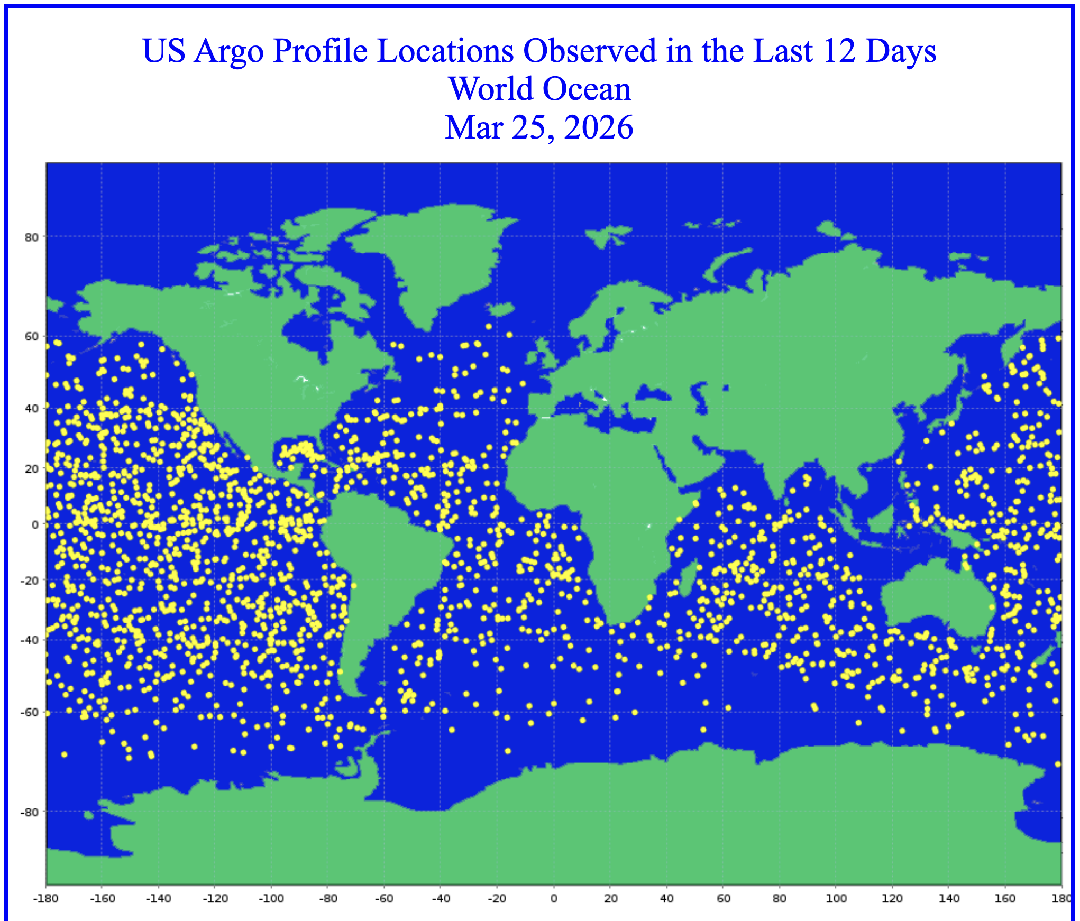

US Argo Profile Locations Observed in the Last 12 Days
World Ocean • Mar 25, 2026
National Oceanic and Atmospheric Administration
Atlantic and Oceanographic and Meteorological Laboratory
Physical Oceanography Division (PhOD)
https://www.aoml.noaa.gov/phod/argo/opr/float_array.php?args=world_12
Notes:
Here’s the real picture from NOAA showing every float that surfaced in the 12 days up to March 25. Look at the poles. Virtually nothing beyond 60 degrees.

Slide 19
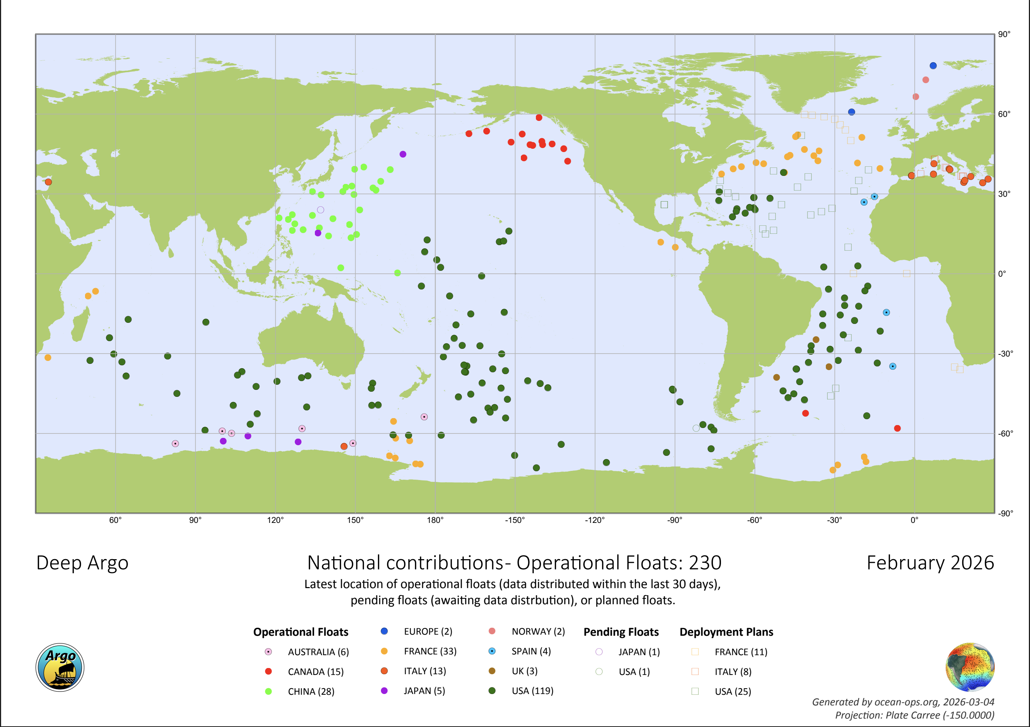
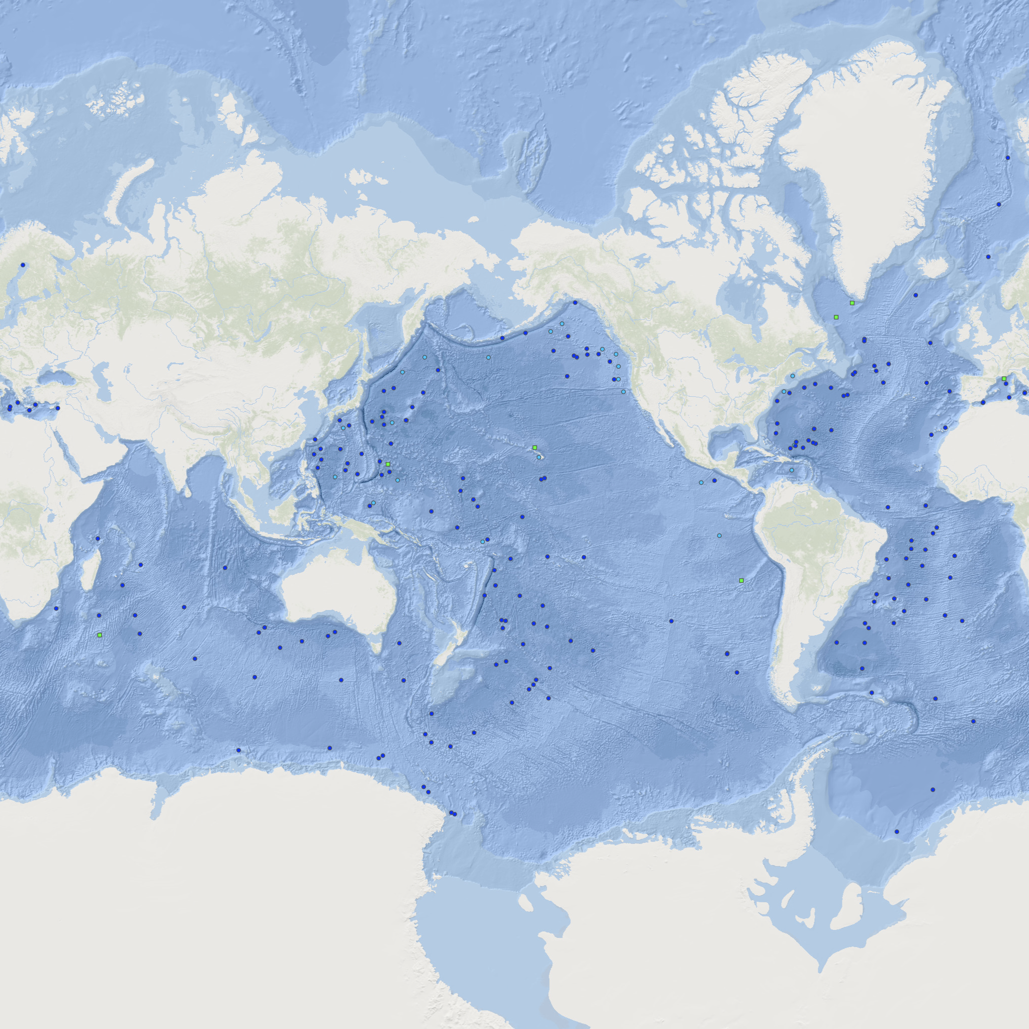
Notes:
And the entire Deep Argo fleet has only 230 floats to sample temperatures in HALF of the ocean volume where literally HALF its thermal energy resides below 2,000 meters.

Slide 20
Notes:
And the entire Deep Argo fleet has only 230 floats to sample temperatures in HALF of the ocean volume where literally HALF its thermal energy resides below 2,000 meters.

Slide 21
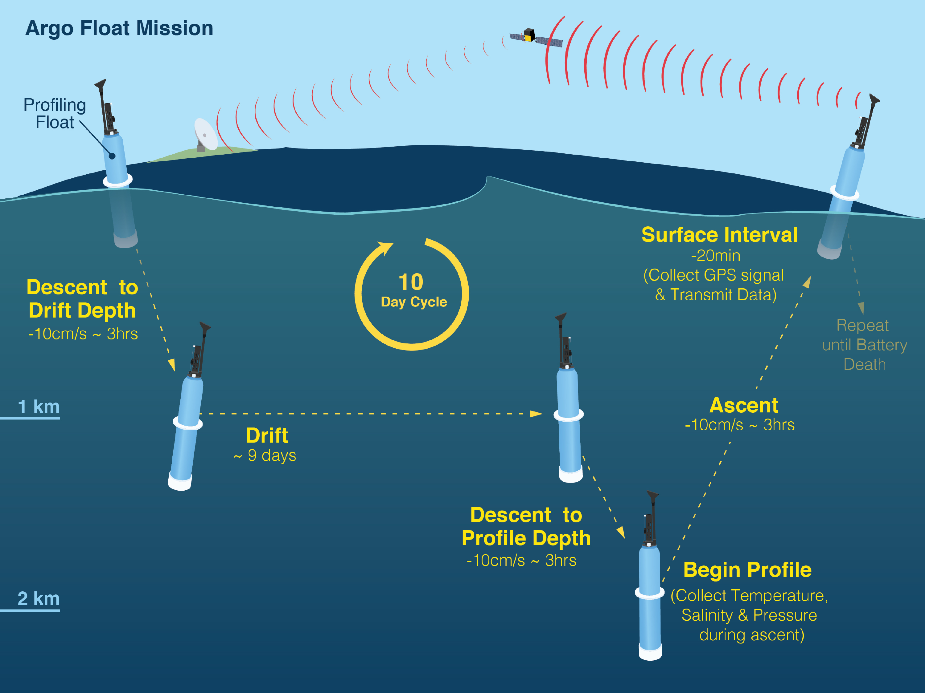
Argo
PROGRAM OVERVIEW
Started: 2000
Active Floats: ~4,400
Output: ~100K profiles/yr (~400/day)
Nations: 30+ contributing
Annual Cost: ~$40M globally
FLOAT TYPES
Core (0–2,000 m): ~3,600
BGC (0-2,000 m): ~600
Deep (0-4,000/6,000 m): ~230
Deep target: 1,228
COVERAGE & SAMPLING
Spacing: 1 float per 3° × 3° box
Cycle: 10-day duty cycle
Replacement: ~500-600 new floats/yr
Data delivery: 90% within 12 hrs
Float cost: $25K–$185K
Source: argo.ucsd.edu / AOML (March 2026)
Notes:
Here’s how each of the 4200 non-Deep floats work:
It descends to 1,000 meters,
drifts for 9 days doing nothing,
drops to 2,000 meters,
ascends slowly over 6 to 10 hours, collecting about 1,000 temperature measurements,
spends about 15 minutes at the surface to get a GPS location and time fix, and
transmits the data to a satellite.
Rinse and repeat for a few years until its battery dies.
This is all valid data gathering.

Slide 22
REALITY ENDS
below this line
From measurement to fiction
Five steps that destroy the physics of Argo data
1
Assign all data to surface GPS fix
No subsurface positioning exists. All ~1,000 measurements from a 6–10 hr ascent assigned to one surface point. Deepest data: up to 50 km upstream, 10 hrs earlier. Actual locations unknown and unknowable.
▼
2
EXtrapolate 12,000 profiles → 45,000 grid cells
100% calculated numbers. Correlation scales of 300–2,800 km blend measurements from different water masses. Monthly bins average profiles up to 30 days apart. Cannot increase information content — can only destroy it.
▼
3
Construct reference climatology, compute ΔT
Same invalid gridding applied over arbitrary 15-yr baseline capturing random ocean cycle phases (ENSO, PDO, AMO). ΔT = ghost minus ghost. Neither number represents any real water mass. Temperature is intensive → non-additive (Essex et al. 2007).
▼
4
Discrete sum (not integral) over grid cells
NOT a mathematical integral — discrete sum of widely separated fabricated ΔT values × fixed ρ × fixed cₚ × ΔV. Non-physical inputs produce non-physical output with units of energy attached by algebraic convention only.
▼
5
Declare result = Ocean Heat Content → EEI
Final scalar (0.7 ± 0.2 W/m²) presented as precision measurement of planetary energy uptake. ~50% of ocean volume unsampled. Polar, coastal, marginal seas excluded. True uncertainty ≥ ±1 W/m² — indistinguishable from zero.
Result: EEI is no different from ZERO.
Notes:
What happens next is where reality departs.
Step one: There is no subsurface positioning. Every measurement from the ascent is assigned to the ONE surface GPS time and location fix. [CLICK]
Step two: 12,000 profiles are EXtrapolated onto 45,000 grid cells using correlation scales up to 2,800 kilometers. Every single gridded value is calculated not measured. This does NOT increase information content; it decreases it. [CLICK]
Step three: the same invalid process constructs a reference climatology over an arbitrary 15-year baseline, adding another layer of invalid averaging, then anomalies are computed. This is what we call the Ghost minus ghost trick. [CLICK]
Step four: a discrete sum, not an integral, over these calculated values times incorrectly assumed constant density and heat capacity. [CLICK]
Step five: the result is declared the EEI at 0.7 plus or minus 0.2 watts per square meter, despite 60% of the ocean left unsampled and a true uncertainty easily exceeding plus or minus one watt per square meter. [CLICK]
The actual result: EEI is no different from zero.

Slide 23
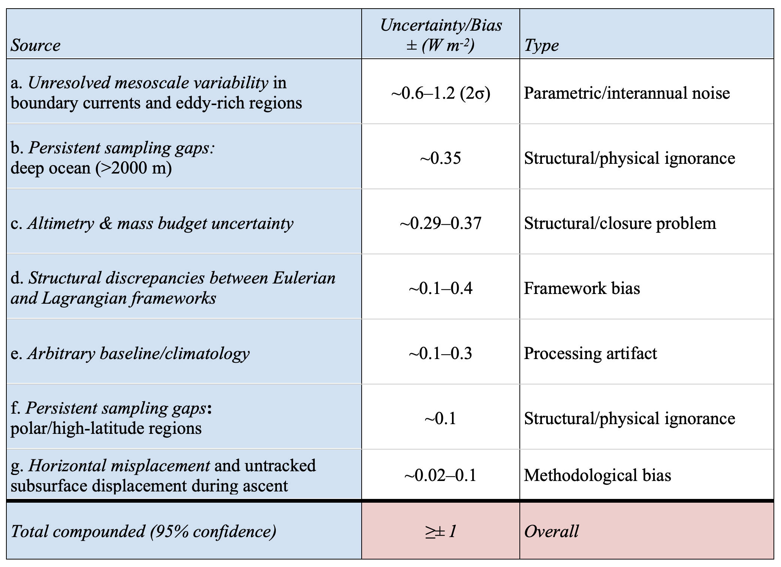
Quantified Sources of Uncertainty and Bias in Argo-based EEI
Notes:
Setting aside the thermodynamic nullification for a moment, there are at least seven independent significant uncertainty sources:
Mesoscale variability is the biggest.
Deep-ocean ignorance.
Sea-level closure from satellite altimetry.
Eulerian-Lagrangian framework bias.
Arbitrary baseline bias.
and two other smaller items.
Compounded at 95 percent confidence, the total easily exceeds plus or minus one watt per square meter. The claimed signal is smaller than the noise.
Even pretending that thermodynamics doesn't exist, how certain is the EEI claim?
Answer: no different from ZERO.

Slide 24




Argo founding objectives (1998)
What Argo was actually designed to do
Physical state of the upper ocean
Regional heat & salinity
Observe the evolving physical state of the upper ocean
Track regional patterns of heat and salinity change
Operational oceanography
Complement Jason altimeters
Support operational oceanography and weather forecasting
Complement the Jason altimeter satellites for sea-level measurements
No mention of global OHC or EEI
Notes:
When Argo was designed in 1998, its objectives were ocean observation and weather forecasting. [CLICK]
No mention of a global OHC or EEI.

Slide 25
The Trenberth ClimateGate email
What followed (2009–2021)
From: Kevin Trenberth <k.trenberth@...>
To: Michael Mann <mann@...>
Cc: S. Schneider, M. Allen, P. Stott, P.D. Jones, B. Santer,
T. Wigley, T.R. Karl, G. Schmidt, J. Hansen, M. Oppenheimer
Subject: Re: BBC U-turn on climate
Date: Mon, 12 Oct 2009 08:57:37 -0600
Trenberth et al. repurposed Argo as global energy accounting tool
Loeb et al. (2009): “objective constrainment” forces CERES → Argo OHC
“The fact is that we can’t account for the lack of warming at the moment and it is a travesty that we can’t.
The CERES data published in the August BAMS 09 supplement on 2008 shows there should be even more warming: but the data are surely wrong. Our observing system is inadequate.”
von Schuckmann et al. (2016): “An imperative to monitor Earth’s energy imbalance”
IPCC AR6 (2021): codified as EEI = 0.7 ± 0.2 W/m²
When satellite measurements disagreed with
the models, they adjusted the measurements.
Notes:
That idea was added a decade later, during ClimateGate, when Kevin Trenberth emailed “hockey stick” Michael Mann and his entire climate-science hockey team saying,
"we can’t account for the lack of warming, and it is a travesty that we can’t. The CERES data… shows there should be even more warming, but the DATA are surely wrong. Our observing system is inadequate.” [CLICK]
From that moment, Argo was essentially repurposed into a global energy accounting tool, and the CERES satellite measurements were forced to match it.

Slide 26
Trenberth’s response to our paper
“It is absolute nonsense.
I do not want to waste
my time on it.”
— Kevin Trenberth,
quoted in Bulletin of the Atomic Scientists on March 19, 2026
Notes:
Our paper, published on March 10, was in total agreement with Trenberth’s initial 2009 assessment, so we were excited to see his nearly immediate response on March 19: [CLICK]
“It is absolute nonsense. I do not want to waste my time on it.”
Clearly, we’re over the target!

Slide 27
The Empty IPCC Circle of Lies
GMST
1. GMST
Global Mean Surface Temperature
Physically Meaningless
2. CMIP
Coupled Model Intercomparison Project
Tuned to match GMST
CMIP
[EMPTY]
3. OHC
Ocean Heat Content
Meaningless Calculation
CO₂
4. EEI
Earth’s Energy Imbalance
“Constrained” by OHC
OHC
5. CO₂
Carbon Dioxide, The Gas of Life
Undetectable Signature
EEI
Each lie leads to the next. None stand on their own.
Notes:
Back to Earth's Energy Imbalance.

Slide 28
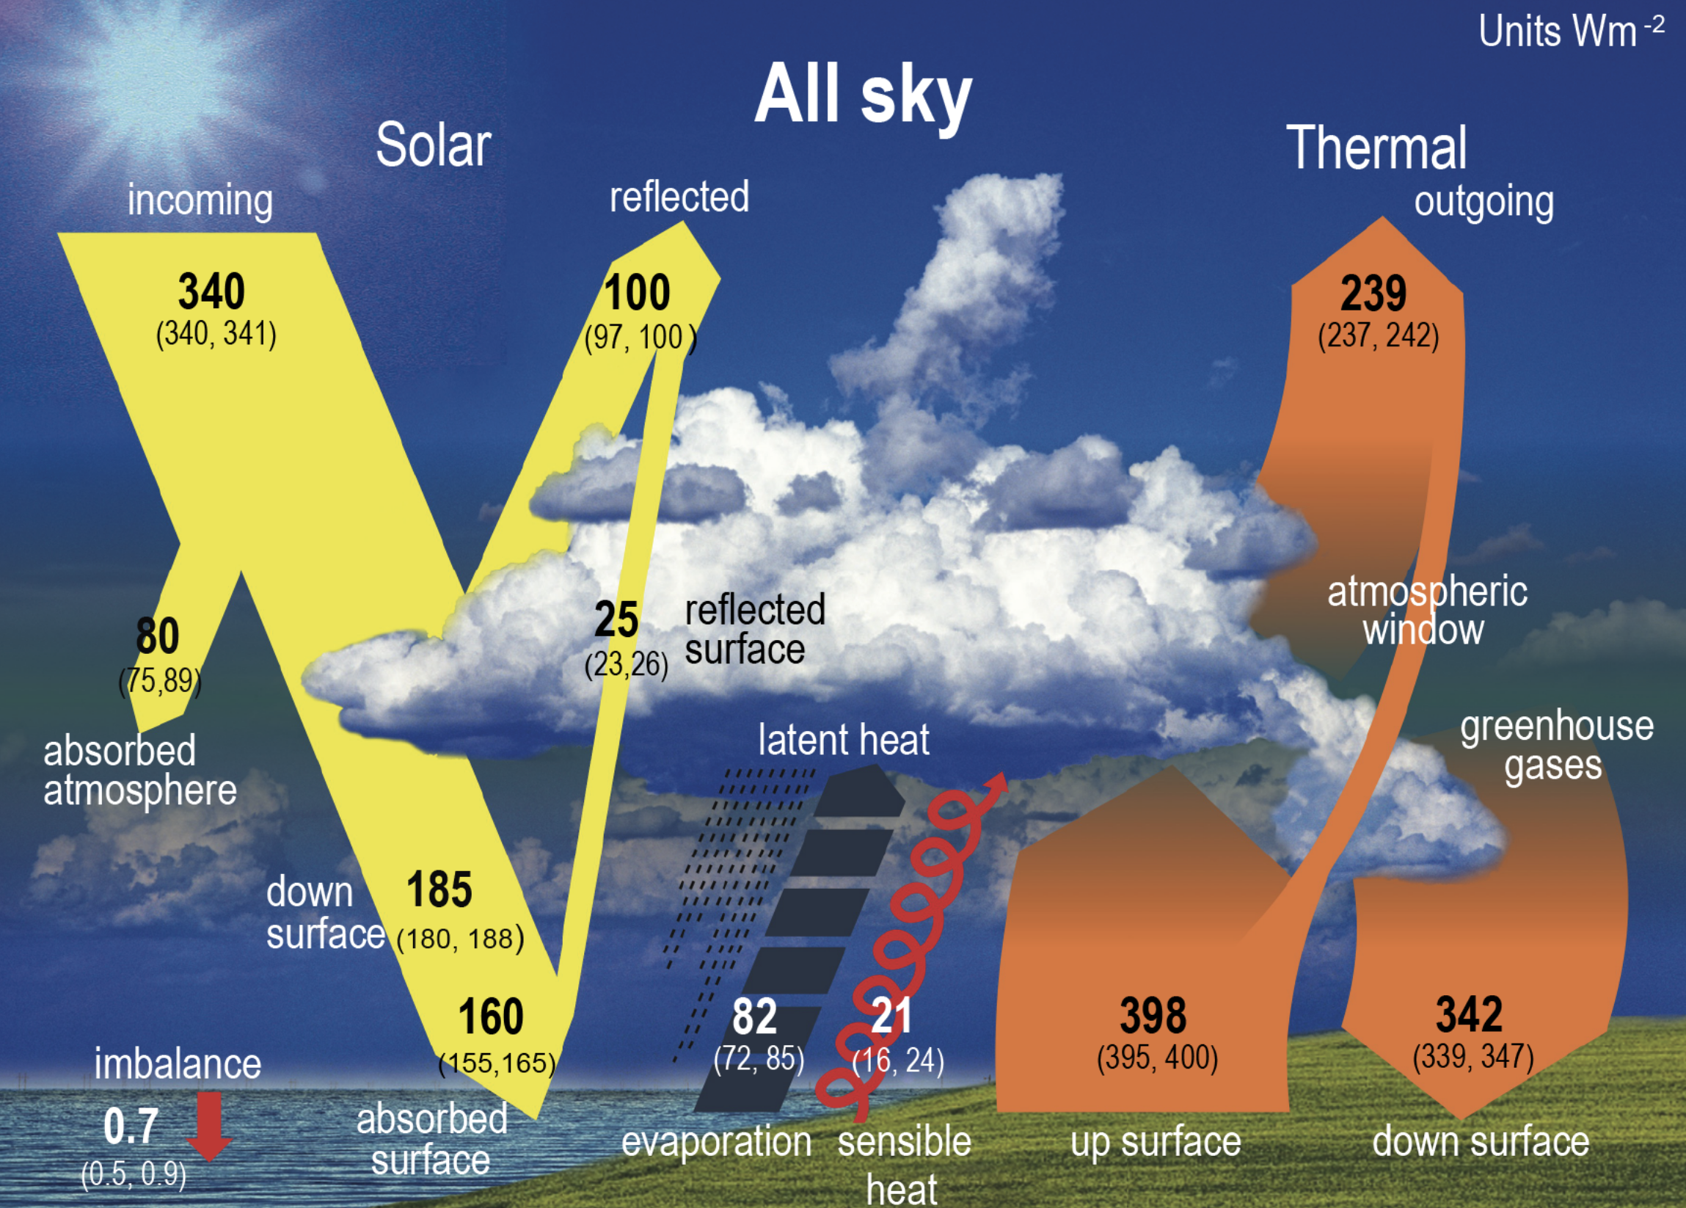
IPCC AR6
Figure 7.2
Schematic representation of the global mean energy budget of the Earth (upper panel), and its equivalent without considerations of cloud effects (lower panel). Numbers indicate best estimates for the magnitudes of the globally averaged energy balance components in W m^{–2} together with their uncertainty ranges in parentheses (5–95% confidence range), representing climate conditions at the beginning of the 21st century.
Notes:
Here’s what the IPCC did. The parentheses show the 90% confidence ranges.
Through what NASA CERES has called both a “one-time global adjustment” and “objective constrainment,” they fudged their numbers to match the Argo-derived OHC estimate. [CLICK]
•Incoming solar is 340 although the range given is 340 to 341; [CLICK]
•Reflected solar is 100, although the range is 97 to 100; and [CLICK]
• Outgoing longwave is 239 although the range is 237 to 242.
The FORCED result: 340 minus 100 minus 239 equals exactly 1.
And voila, it “matches” the OHC-derived EEI [CLICK].
BUT using the actual IPCC uncertainty ranges, EEI could be anything from −2 to +7!
Also remember, NASA CERES IS a direct measurement while OHC is an invalid calculation!

Slide 29
IPCC AR6
Figure 7.2
Schematic representation of the global mean energy budget of the Earth (upper panel), and its equivalent without considerations of cloud effects (lower panel). Numbers indicate best estimates for the magnitudes of the globally averaged energy balance components in W m^{–2} together with their uncertainty ranges in parentheses (5–95% confidence range), representing climate conditions at the beginning of the 21st century.
Notes:
Here’s what the IPCC did. The parentheses show the 90% confidence ranges.
Through what NASA CERES has called both a “one-time global adjustment” and “objective constrainment,” they fudged their numbers to match the Argo-derived OHC estimate. [CLICK]
•Incoming solar is 340 although the range given is 340 to 341; [CLICK]
•Reflected solar is 100, although the range is 97 to 100; and [CLICK]
• Outgoing longwave is 239 although the range is 237 to 242.
The FORCED result: 340 minus 100 minus 239 equals exactly 1.
And voila, it “matches” the OHC-derived EEI [CLICK].
BUT using the actual IPCC uncertainty ranges, EEI could be anything from −2 to +7!
Also remember, NASA CERES IS a direct measurement while OHC is an invalid calculation!

Slide 30
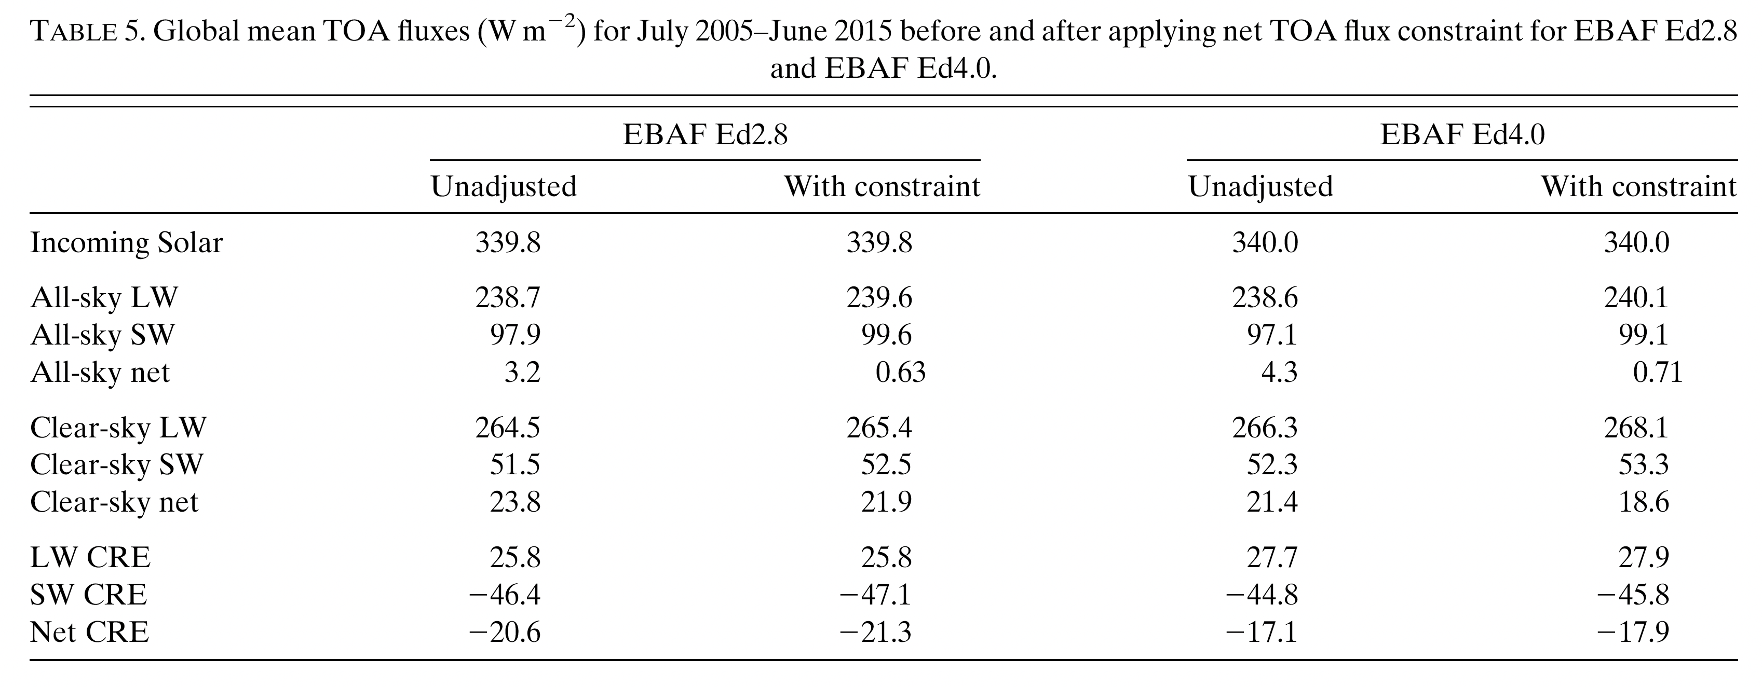
The IPCC / NASA CERES EEI Numbers Game for Global Mean TOA fluxes

Slide 31
The IPCC / NASA CERES EEI Numbers Game for Global Mean TOA fluxes

Slide 32
CERES-Argo circularity
Global adjustment forces
NASA CERES to match Argo
Argo OHC
Argo OHC-derived EEI
EEI = 0.7 ± 0.2 W/m²
Physically invalid.
Uncertainty > ±1 W/m²
NASA CERES unadjusted
EEI = 4.3 ± ????? W/m²
Cannot resolve EEI
↻
“Agreement” cited as
independent confirmation
“the CERES EBAF reflected solar and emitted thermal TOA fluxes were adjusted, within the estimated uncertainties, to ensure that the net TOA flux for July 2005 to June 2015 was consistent with the estimated Earth’s energy imbalance for the same period based on ocean heat content (OHC) measurements…” — (IPCC AR6 WGI, p. 935)
This is circular reasoning, not validation.
Notes:
You may be wondering what just happened…
On the right, the unadjusted CERES satellite measurements give 4.3 ± 8 W/m² at 95% confidence.
It can’t resolve the EEI signal. PERIOD. [CLICK]
On the left, Argo-derived OHC claims 0.7 ± 0.2 watts per square meter, but actual uncertainties easily exceed ±1. [CLICK]
The “one-time global adjustment” forces CERES to match Argo. The resulting agreement is then cited as “independent confirmation.” [CLICK]
Circular reasoning, not validation.

Slide 33
The Empty IPCC Circle of Lies
GMST
1. GMST
Global Mean Surface Temperature
Physically Meaningless
2. CMIP
Coupled Model Intercomparison Project
Tuned to match GMST
CMIP
[EMPTY]
3. OHC
Ocean Heat Content
Meaningless Calculation
CO₂
4. EEI
Earth’s Energy Imbalance
“Constrained” by OHC
OHC
5. CO₂
Carbon Dioxide, The Gas of Life
Undetectable Signature
EEI
Each lie leads to the next. None stand on their own.
Notes:
Now let’s close the loop with the CO2 story, where the IPCC has causality backwards.
In every paleoclimate record—Antarctic ice cores, Greenland, the entire 500-million-year Phanerozoic record—temperature changes precede CO2 changes. Always. Without exception.
Even El Nino warming events precede CO2 spikes by six months. And we know the physics: warmer water outgasses more CO2.
IPCC’s central assumption that CO2 causes temperature increases has never been observed in any paleoclimate record on any timescale.

Slide 34
The Bomb-Radiocarbon “Experiment”
The largest deliberate-or-accidental tracer experiment in scientific history
oceanography • hydrology • soil science • forensics • cell biology • carbon cycle
1955 – 1963
U.S. and Soviet atmospheric thermonuclear (hydrogen bomb) tests doubled atmospheric ¹⁴C
1963
Limited Test Ban Treaty halted the pulse
1950 – 2019
70 years of continuous ¹⁴C measurement (Hua et al. 2022)
Nature’s pulse. The atmosphere’s response.
The IPCC has known this data for forty years.

Slide 35
AR6 Glossary, Annex VII, Page 2237
Two atmospheric CO₂ timescales, defined by the IPCC, both pinned by direct measurement.
DEFINITION 1 — Turnover time
DEFINITION 2 — Adjustment time
“Carbon dioxide (CO₂) is an extreme example. Its turnover time is only about 4 years because of the rapid exchange between the atmosphere and the ocean and terrestrial biota.”
“Response time or adjustment time (T_{a}) is the time scale characterizing the decay of an instantaneous pulse input into the reservoir.”
✓ τ_{res} ≡ 3.80 ± 0.12 yr
Koutsoyiannis (RRR): Mauna Loa + Barrow
✓ τ_{rel} ≡ 18.383 ± 0.015 yr
Bomb radiocarbon Δ¹⁴C ratio decay, 54 years
Same physics. Two windows. Bridge equation:
τ_{rel} / τ_{res} = 𝒟 / ɸ_{slow}
The Δ¹⁴C ratio relaxes slower than the bulk by the disequilibrium over the deep mixed leak fraction.
Neither is 1,000, 10,000 or 100s of thousands of years.
Both are determined by direct measurement.

Slide 36
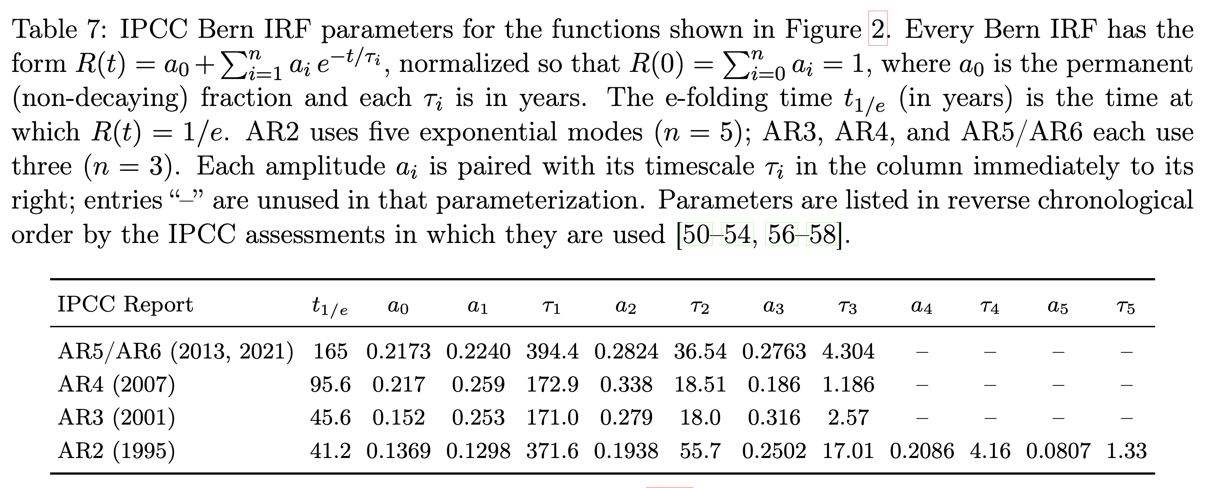
IPCC Bern impulse-response functions:
AR2 through AR6

Slide 37
IPCC Bern impulse-response functions:
AR2 through AR6
Permanent fraction plus multi-exponential

Slide 38
The IPCC Bern impulse-response functions:
AR2 through AR6

Slide 39
The IPCC Bern impulse-response functions:
AR2 through AR6

Slide 40
The IPCC Bern impulse-response functions:
AR2 through AR6

Slide 41
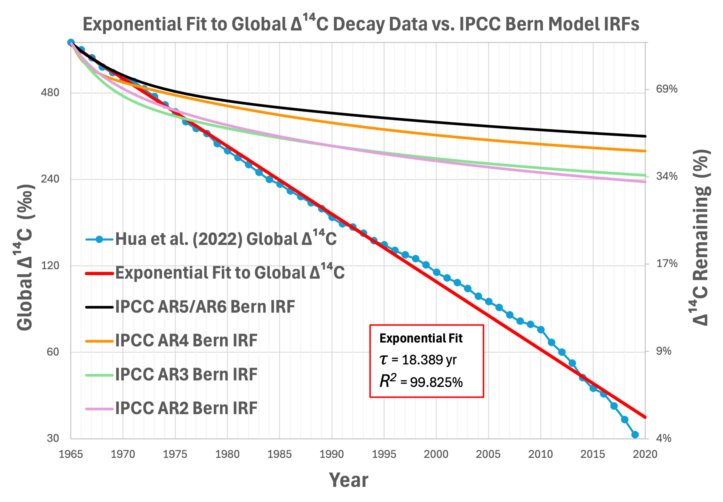
Wider and Wider Departure from Observation
Notes:
The Bern impulse response function (IRF) models govern IPCC estimates of how long CO₂ purportedly WILL stay in the atmosphere. The three versions are:
AR2
[CLICK] AR3 and 4 (absurd 15% forever)
[CLICK]AR5 and 6 (absurd 22% forever)
These IRF models are simplified, multi-exponential models fit exclusively to the output of more complex models NOT to ANY measurements.
In other words, they are not normal models—they are models of models, or models of model ensembles—each of which was tuned to, you guessed it, physically meaningless GMST.
Using these, IPCC guarantees us CO₂ “WILL” persist for hundreds, thousands, and even tens of thousands of years.
But LOOK at the dark blue, green and orange curves. These Bern curves don’t even match amongst themselves on either short OR long timescales. NOT EVEN CLOSE.
If the Bern models were representing reality, successive refinements would produce convergence not chaos.

Slide 42
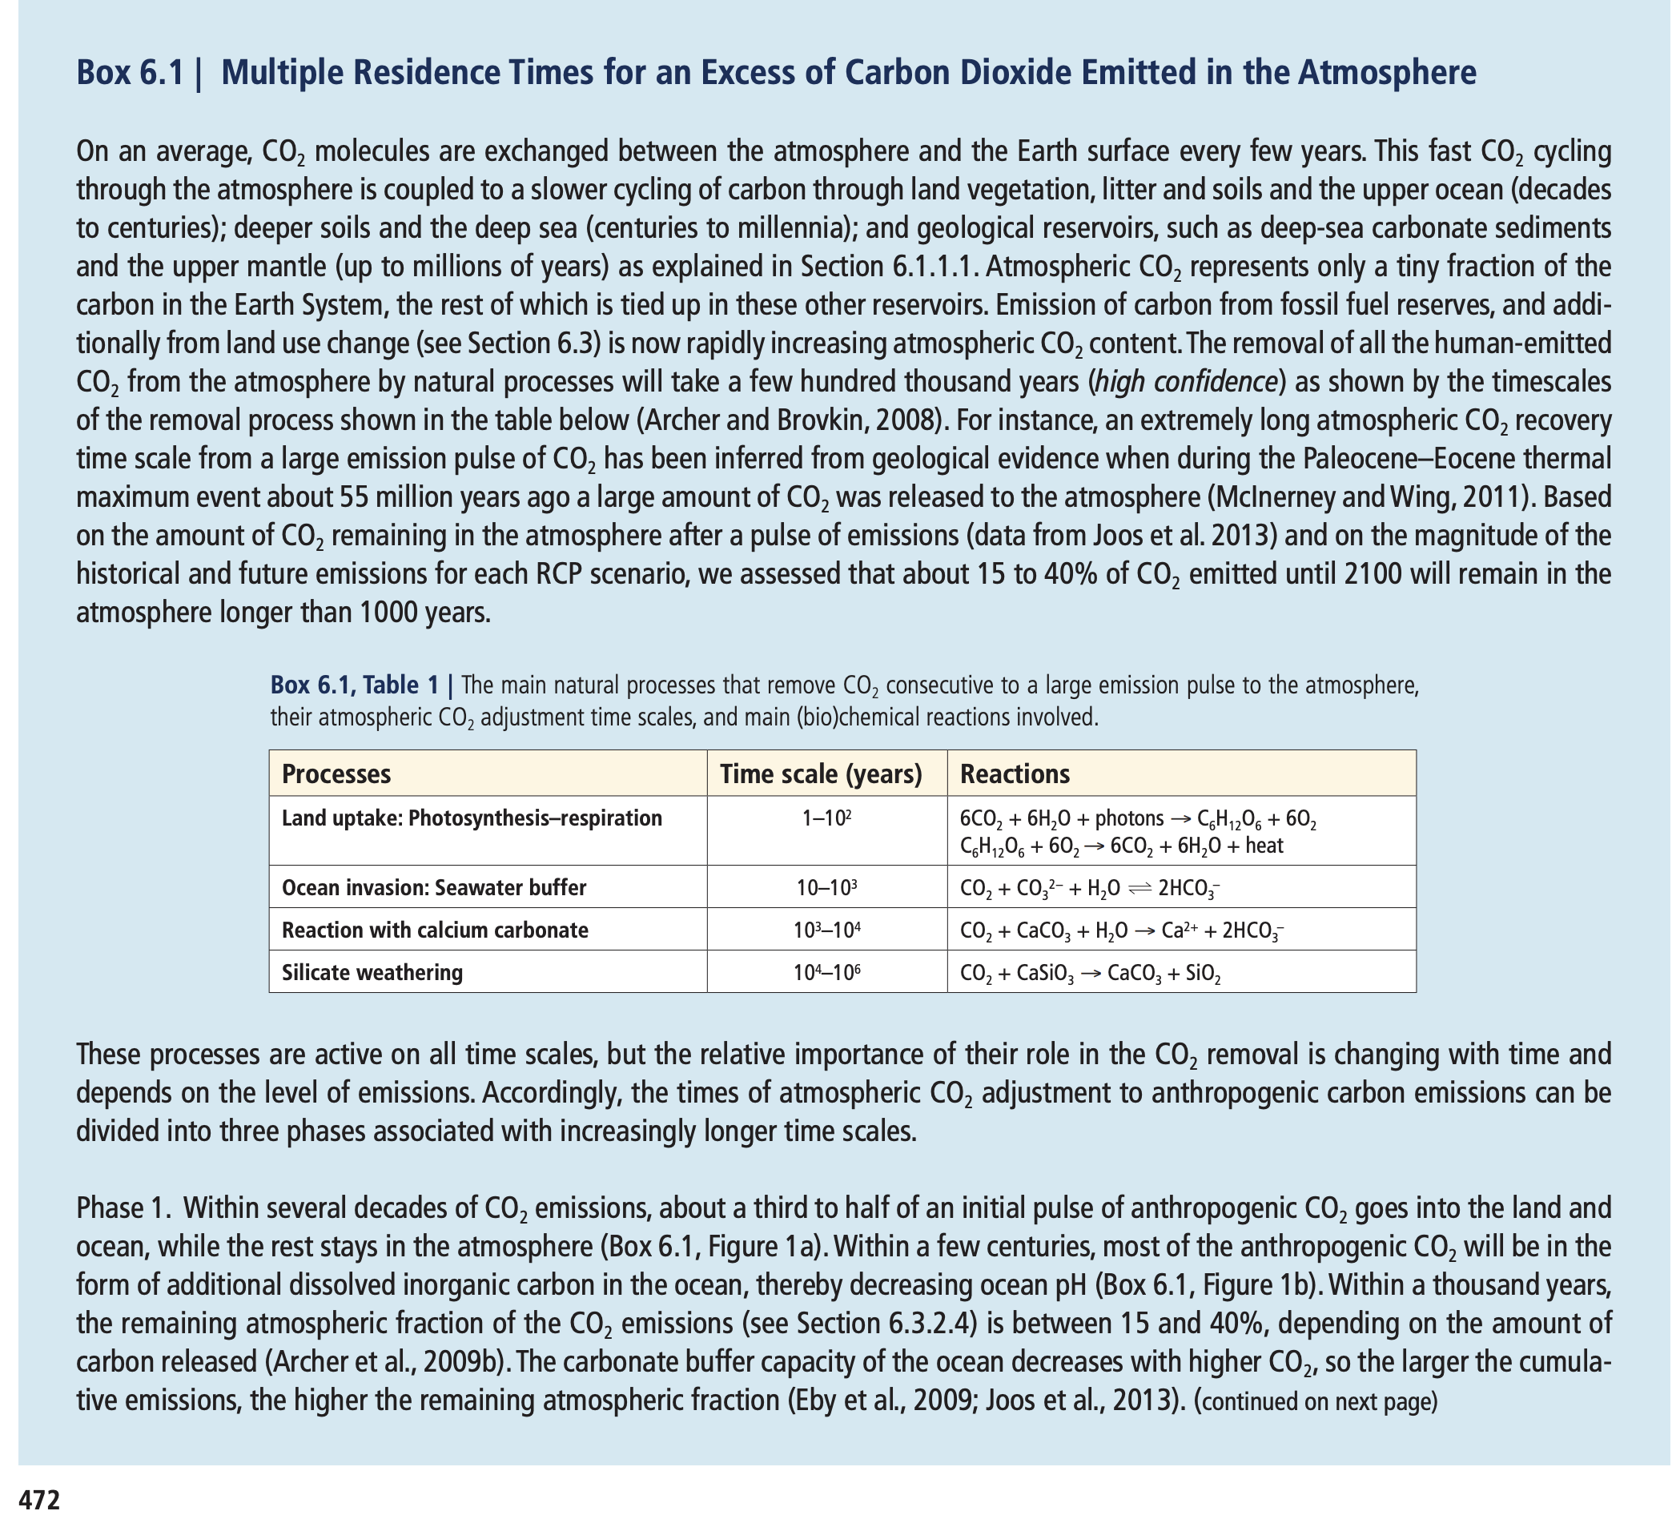
IPCC AR5 Box 6.1: Multiple Residence Times for an Excess of Carbon Dioxide Emitted in the Atmosphere
Notes:
And all of that is not to mention something even more damning…
The scientists who created the Bern models warned us:
> “the coefficients and timescales … should not be interpreted literally as distinct physical processes or timescales.”
So, what did the IPCC do?
They published Box 6.1 in AR5 — doing exactly the opposite! [CLICK]
In there, they claim to have used “data” from Joos et al. 2013.
BUT there is no empirical data whatsoever in Joos et al. 2013. NONE.
Joos ran three complex models for about 100 years, and a handful of much simpler models out to 1000 years. NONE of these models has ever been validated — or even shown to be remotely realistic over multi-century timescales. Yet the IPCC declared, with high confidence, that [CLICK] “15 to 40 % of all the CO₂ we emit between now and 2100 will remain in the atmosphere longer than 1000 years”!

Slide 43
IPCC AR5 Box 6.1: Multiple Residence Times for an Excess of Carbon Dioxide Emitted in the Atmosphere
“15 to 40% of CO₂ emitted until 2100 will remain
in the atmosphere longer than 1000 years.”
—IPCC AR5
Notes:
And all of that is not to mention something even more damning…
The scientists who created the Bern models warned us:
> “the coefficients and timescales … should not be interpreted literally as distinct physical processes or timescales.”
So, what did the IPCC do?
They published Box 6.1 in AR5 — doing exactly the opposite! [CLICK]
In there, they claim to have used “data” from Joos et al. 2013.
BUT there is no empirical data whatsoever in Joos et al. 2013. NONE.
Joos ran three complex models for about 100 years, and a handful of much simpler models out to 1000 years. NONE of these models has ever been validated — or even shown to be remotely realistic over multi-century timescales. Yet the IPCC declared, with high confidence, that [CLICK] “15 to 40 % of all the CO₂ we emit between now and 2100 will remain in the atmosphere longer than 1000 years”!

Slide 44
IPCC Bern impulse-response functions:
AR2 through AR6
Permanent fraction plus multi-exponential

Slide 45
Bern is Parallel. Reality is Serial.
BERN: AR5/AR6 parallel drains
REALITY: serial cascade
ATMOSPHERE
ATMOSPHERE
SURFACE OCEAN
fast
τ = 4.304 yr
medium
τ = 36.54 yr
slow
τ = 394.4 yr
permanent
τ = ∞ yr
THERMOCLINE
DEEP OCEAN / SEDIMENT
R(t) = Σ a_{i} exp(−t/τ_{i})
Atmospheric decay through ocean surface ONLY.
Sum of exponentials = parallel independent drains
Single eigenmode → single exponential decay
The >=1000-year tail is a mathematical artifact of
FALSE assumptions. Reality is serial NOT parallel.

Slide 46
Whack-a-Lie: The 1000-Year Defense
Each rhetorical diversion is unsupported by evidence and closed by math or measurement.
1
TRACER vs BULK
“¹⁴C is just isotopic exchange, not the bulk”
No evidence. Closed by OET: same operator, same eigenvalues.
2
PULSE TOO SMALL
“Revelle nonlinearity kicks in at larger mass”
No evidence. OET closes again: eigenvalues are intrinsic, not amplitude-dependent.
1000-Year Tail
3
REVELLE + DEEP CIRC
“Slow ocean mixing manufactures the tail”
No evidence. Parallel-serial fallacy: deep ocean is downstream, not in parallel.
Zero evidence. Whack one lie, another pops up.
The rotation IS the defense.

Slide 47
Airborne Fraction: Two Quantities, One Name
ABF_{L}
the IPCC's own glossary definition
Cumulative anthropogenic mass
still airborne
÷
cumulative emissions
Under mass-balance, τ = 3.8 yr:
≈ 5.3%
ABF_{C}
what the IPCC actually reports
Annual atmospheric increase
÷
annual emissions
(a single-year rate ratio)
Year-by-year, 1966–2019:
17.9 – 77.4%
"Stable 44%" requires 15–30 yr smoothing.
Same name. Different quantities.
Order of magnitude apart.

Slide 48
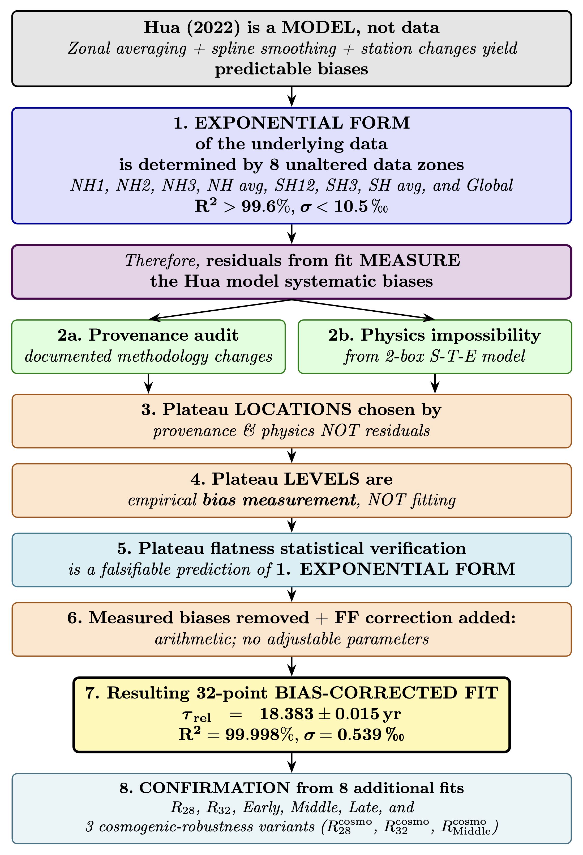

Slide 52
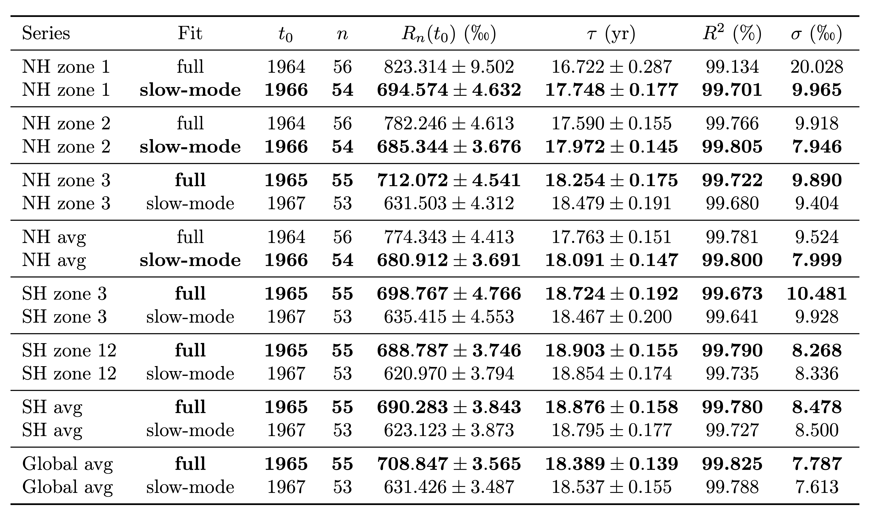
Single-Exponential Zonal Fits of Bomb Radiocarbon Data

Slide 53
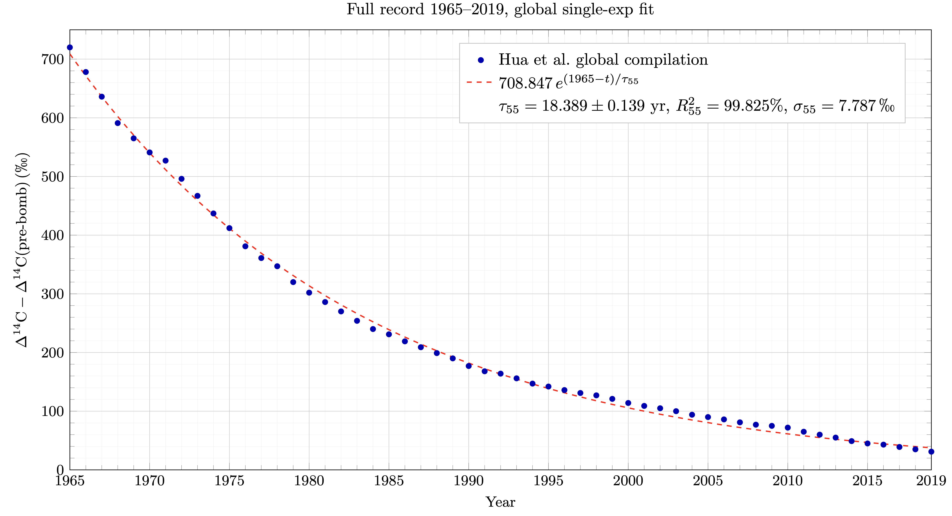
Global radiocarbon single-exponential fit
Δ¹⁴C – Δ¹⁴C pre-bomb (‰)

Slide 54
Global radiocarbon single-exponential fit
Δ¹⁴C – Δ¹⁴C pre-bomb (‰)

Slide 57
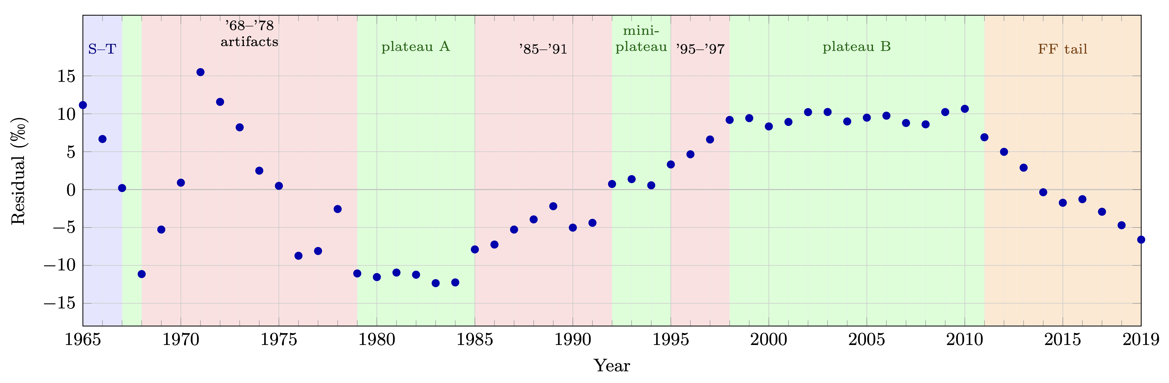
Residuals Measure the Model Biases

Slide 62
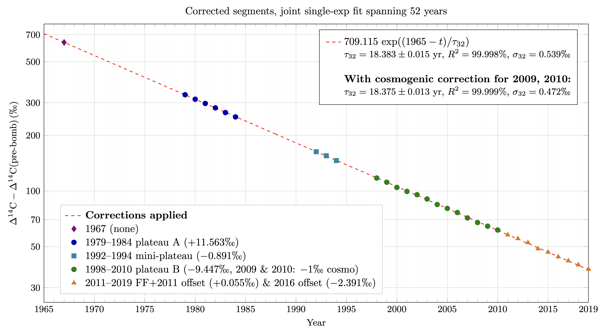
Bias-corrected joint single-exponential fit of 32 points spanning 52 years

Slide 63
Bias-corrected joint single-exponential fit of 32 points spanning 52 years

Slide 64
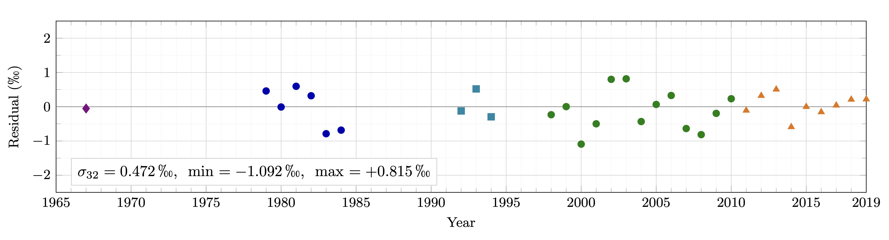
After Bias Corrections
All Residuals Random and Below Noise Floor

Slide 65
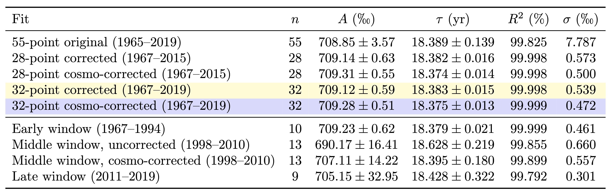
If the data fits, you must admit!

Slide 66
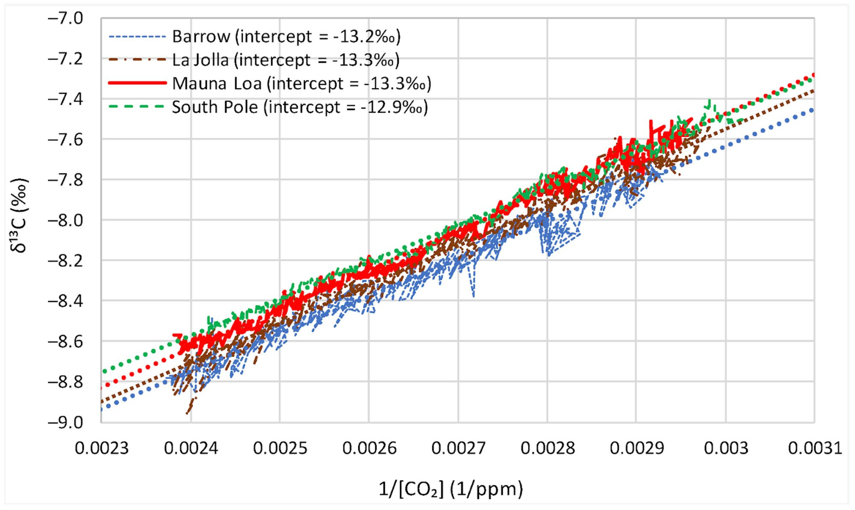
Keeling plot data from Koutsoyiannis (2024), reproduced under CC-BY 4.0. Analysis from Cohler & Soon (2026), under review.
Notes:
One of the most pivotal findings in modern climate science is this “Keeling plot” of four stations spanning 40 years from Koutsoyiannis 2024.
The legend shows the y-intercept for each station, which is the net isotopic signature of what was added to the atmosphere over the 40 years. It averages −13.2‰. This is standard reservoir mass-balance analysis, routine in hydrology, but nobody had ever done it in climate science until Koutsoyiannis.
Critically, this intercept didn’t budge while emissions tripled. Using proxy data, Koutsoyiannis extended his finding back 500 years to the Little Ice Age, and the intercept remains the same.
Why does this matter? Fossil fuels have a net input signature around −28‰.
If human emissions were adding to the atmosphere, as the IPCC claims, the intercept of would be moving down from -13.2 toward -28‰.
But it hasn’t budged.
It does match temperature-driven biosphere expansion, however. And natural fluxes at 20 times human CO2 emissions render the man-made signal totally undetectable.
This is direct empirical falsification of the IPCC’s assumption that manmade CO2 is increasing in the atmosphere. They never did and still don’t have any actual evidence to support their claim.

Slide 67
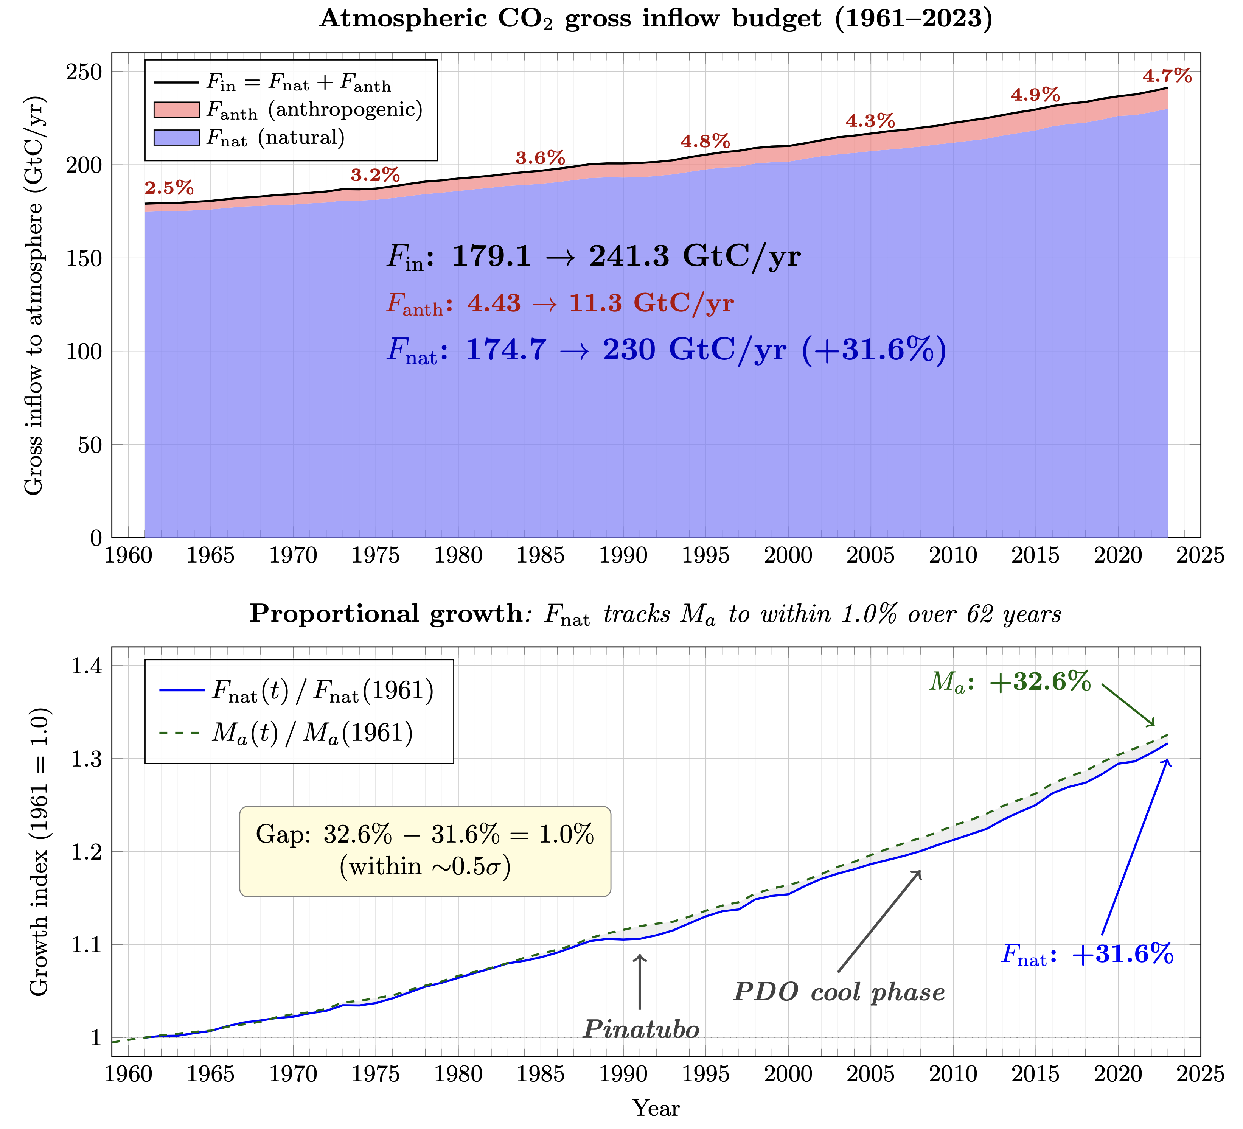
Atmospheric rise of CO2 over 62 years was all natural.
Human
Contribution: negligible.

Slide 68
The Empty IPCC Circle of Lies
GMST
1. GMST
Global Mean Surface Temperature
Physically Meaningless
2. CMIP
Coupled Model Intercomparison Project
Tuned to match GMST
CMIP
[EMPTY]
3. OHC
Ocean Heat Content
Meaningless Calculation
CO₂
4. EEI
Earth’s Energy Imbalance
“Constrained” by OHC
OHC
5. CO₂
Carbon Dioxide, The Gas of Life
Undetectable Signature
EEI
Each lie leads to the next. None stand on their own.
Notes:
Now, CMIP. The climate models.

Slide 69
Every IPCC Climate Metric is Physically Meaningless
Calculation methodologies nullify connection to physical reality
Metric | IPCC Theoretical Definition | How/Why the Methodology Nullifies Physical Meaning | AR6 Chapters
Global Mean Surface Temperature (GMST) | Global average of blended near-surface air temperature (land) and sea-surface temperature (ocean), expressed as anomaly from a baseline period. | Global aggregation of local intensive temperature over a macroscopic non-equilibrium system with no unique law-governed aggregator (arbitrary averaging operator among infinitely many possibilities). | Chapters 1, 2, 3, 4, 5, 6, 7, 9, 10, 11, 12; Technical Summary; Summary for Policymakers
Global Surface Air Temperature (GSAT) | Global-mean near-surface air temperature (2 m over land and sea ice, air temperature over ocean in models). | Same intensive-temperature averaging failure as GMST; models tune to reproduce it, inheriting the physically meaningless construct. | Chapters 1, 3, 4, 7; Technical Summary; Summary for Policymakers
Global Sea Surface Temperature (Global SST / mean SST) | Global average of sea-surface temperature (uppermost ocean layer). | Intensive temperature averaged over non-equilibrium ocean surface; same non-additivity and arbitrary gridding/averaging as GMST/GSAT. | Chapter 9 (primary); Chapters 2, 3, 4, 11
Emission Metrics (GWP, GTP, CGTP, GWP*, AGWP, AGTP) | Family of metrics comparing climate effects of non-CO₂ gases to CO₂ via integrated forcing, endpoint temperature, or hybrid pulse/rate ratios. | All variants rely on the Bern-model multi-exponential IRF (permanent a₀ fraction + multiple timescales), falsified by bomb-¹⁴C single-exponential decay. Temperature variants additionally depend on physically meaningless ECS. | Chapters 6, 7, 7 SM; Annex III; Technical Summary
Ocean Heat Content anomalies (OHC) | Integrated change in ocean thermal energy content, computed as anomaly from a reference climatology. | Intensive temperature anomalies averaged/interpolated over non-equilibrium volumes; untracked float trajectories, arbitrary positional assignment, dominant interpolation in unsampled regions, Eulerian–Lagrangian mismatch. | Chapters 2, 3, 5, 7, 9; Technical Summary
Earth Energy Imbalance (EEI) | Net radiative imbalance at top-of-atmosphere (or derived from OHC change). | Inherits all OHC flaws; CERES TOA fluxes are “adjusted” via least-squares to match the invalid OHC-derived value (circularity). | Chapters 7, 9; Technical Summary; Summary for Policymakers
Equilibrium Climate Sensitivity (ECS) | Long-term global surface temperature change after doubling CO₂ once the system reaches equilibrium. | Defined as GMST/GSAT change per CO₂ doubling; physically meaningless GMST/GSAT makes ECS physically meaningless by construction. | Chapters 4, 5, 7; Technical Summary; Summary for Policymakers
Transient Climate Response (TCR) | Global surface temperature change at the time of CO₂ doubling under 1 % yr⁻¹ increase. | Depends on physically meaningless GMST/GSAT and Bern-model IRF in transient simulations. | Chapters 4, 5, 7; Technical Summary
Transient Climate Response to Cumulative Emissions (TCRE) | Global temperature change per 1000 GtC of cumulative CO₂ emissions. | Linear relationship based on physically meaningless GMST/GSAT + invalid Bern-model CO₂ response. | Chapters 5, 7; Technical Summary; Summary for Policymakers
Remaining Carbon Budgets | Cumulative CO₂ emissions still allowable to stay below a given warming limit. | Directly derived from physically meaningless TCRE + physically meaningless GMST/GSAT and Bern-model CO₂ persistence. | Chapters 5, 7; Technical Summary; Summary for Policymakers
Effective Radiative Forcing (ERF) / Global Radiative Forcing | Net change in downward radiative flux at top-of-atmosphere after rapid adjustments (excluding surface-temperature response). | Global-mean scalar of intensive radiative effects over non-equilibrium system; computed via models tuned to physically meaningless GMST and using Bern-model CO₂ reference. | Chapters 6, 7; Annex III; Technical Summary
Every IPCC Climate Metric
is Physically Meaningless
Notes:
This table catalogs the damage.
EVERY single IPCC climate metric—GMST, OHC, EEI, ECS, TCR, the carbon budgets, and ten others— is physically meaningless. No exceptions. PERIOD.
Not because the measurements are imprecise, but because the calculation methodologies themselves destroy any connection to physical reality: through circular reasoning, invalid temperature averaging, or the falsified Bern CO₂ model. [CLICK]
Column three lays out the specific failures for each.
Column four shows how deeply AR6 depends on them.
These aren’t independent metrics.
They’re the same zeros, repackaged over and over again.

Slide 70
The Empty IPCC Circle of Lies
GMST
1. GMST
Global Mean Surface Temperature
Physically Meaningless
2. CMIP
Coupled Model Intercomparison Project
Tuned to match GMST
CMIP
5 × 0 = 0
3. OHC
Ocean Heat Content
Meaningless Calculation
“Multiple Lines
of Evidence”
[EMPTY]
CO₂
4. EEI
Earth’s Energy Imbalance
“Constrained” by OHC
OHC
5. CO₂
Carbon Dioxide, The Gas of Life
Undetectable Signature
EEI
Each lie leads to the next. None stand on their own.
Notes:
Now let me lay the full circle before you.
GMST is physically meaningless.
CMIP models are tuned to GMST, inheriting total invalidity.
OHC is calculated through the same invalid temperature averaging process and dominated by extrapolation.
EEI actual uncertainty is an order of magnitude larger than IPCC claims and relies on circular adjustment via OHC. Purported EEI is then used as “proof” of human CO₂ forcing.
Rising CO₂ is erroneously attributed to humans and claimed to drive GMST, closing the circle. The Bern models, falsified by bomb carbon-14 data and contradicted by isotopic evidence, are used to assert long-term CO₂ persistence.[CLICK]
The IPCC calls this "multiple lines of evidence.” [CLICK]
Math reminds us that five times zero is still zero.

Slide 71
38 Years. All Lies. Zero Foundation.
1
✗
2
✗
3
✗
4
✗
5
✗
GMST
Physically meaningless
CMIP
Tuned to a fiction
OHC
Physically meaningless
EEI
Statistically zero
CO₂
Growth is natural
...and 30+ more “metrics” that are physically meaningless.
Every construct. Every metric. Every claim. All falsified.
“Philosophy is written in this grand book, the universe...
It is written in the language of mathematics…”
— Galileo Galilei, Il Saggiatore, 1623
Words lied. Math did not.

Slide 72
The IPCC Circle of Lies
Five Papers Falsify
the Entire Framework
Jonathan Cohler
cohler@post.harvard.edu
17th International Climate and Energy Conference (IKEK-17)
June 26-27, 2026
Halle an der Saale
Notes:
The Emperor Has No Clothes. You know the story. Swindlers convince an entire kingdom to applaud robes that don't exist, until one child states the obvious.
Our version is worse than Andersen’s, though, because in ours the swindlers took over the schools.

Slide 73
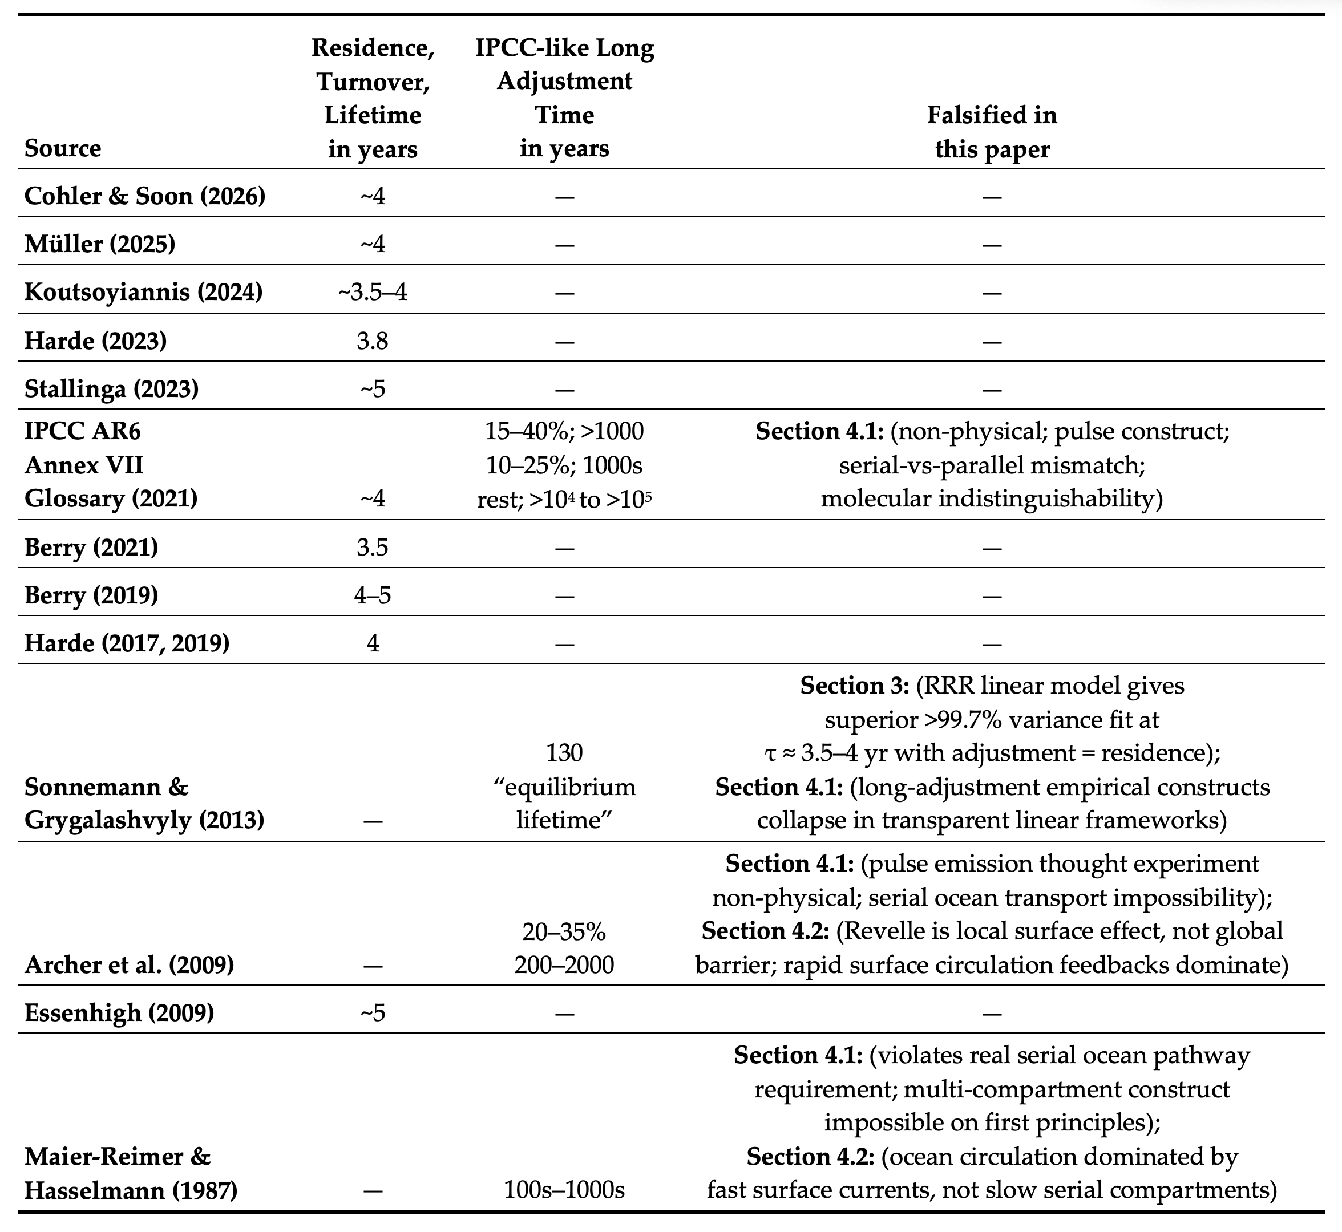
Updates Sundquist (1985) and Segalstad (1998). All modern transparent models find short residence/adjustment times (~4 yr). The three papers outside Joos et al. defending long adjustment times are each falsified by Cohler & Soon (2026), under review.
Notes:
This table is our extension to Segalstad’s compilation of 25 independent studies over several decades all showing short CO₂ residence times from 5 to 10 years— and all ignored by the IPCC. [CLICK]
The modern studies we added here converge even more tightly around 4 years, with adjustment time equal to residence time.
The only sources claiming long adjustment times of centuries to millennia are the IPCC and three old Bern-model predecessor papers, each of which we falsify in our CO2 paper.
No long adjustment time has ever been supported by a single empirical measurement.

